Slide 1
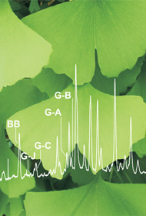
Sources of Information about pre-DSHEA Dietary Ingredients
Joseph M. Betz, Ph.D.
Office of Dietary Supplements
National Institutes of Health

Slide 2
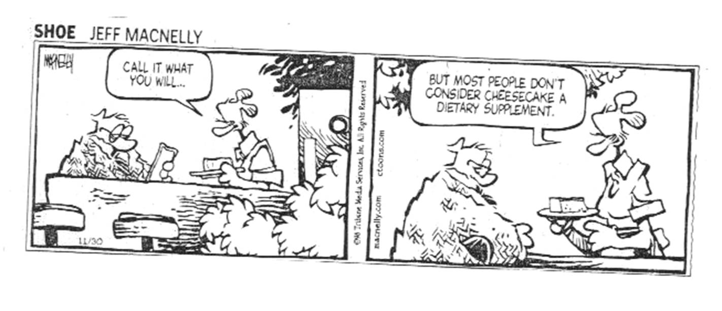
Disclaimer
Views expressed are my own and do not reflect the views of ODS, NIH, or HHS

Slide 3
Definitions
§8. New Dietary Ingredients.
Chapter IV of the FD & C Act is amended by adding at the end the following:
“NEW DIETARY INGREDIENTS
”SEC. 413. (a) IN GENERAL.- A dietary supplement which contains a new dietary ingredient shall be deemed adulterated under section 402(f) unless it meets one of the following requirements:
“(1) The dietary supplement contains only dietary ingredients which have been present in the food supply as an article used for food in a form in which the food has not been chemically altered.
“(2) There is a history of use or other evidence of safety establishing that the dietary ingredient of the dietary supplement will reasonably be expected to be safe and,…” DEFINITION. - For purposes of this section, the term “new dietary ingredient” means a dietary ingredient that was not marketed in the United States before October 15, 1994 and does not include any dietary ingredient which was not marketed in the United States before October 15, 1994.”

Slide 4
Documentary Evidence of ODI Status
Shipping documents from importers
Bills of Lading
Records from contract manufacturers
Catalogs
FDA taught a microscopy course in the 1990’s
(Stan Cichowicz, George Ziobro, John Gecan, Bill Obermeyer, me)
We purchased powdered materials from Penn Herb, Frontier Herb, others

Slide 5
1990 Edition

Slide 6
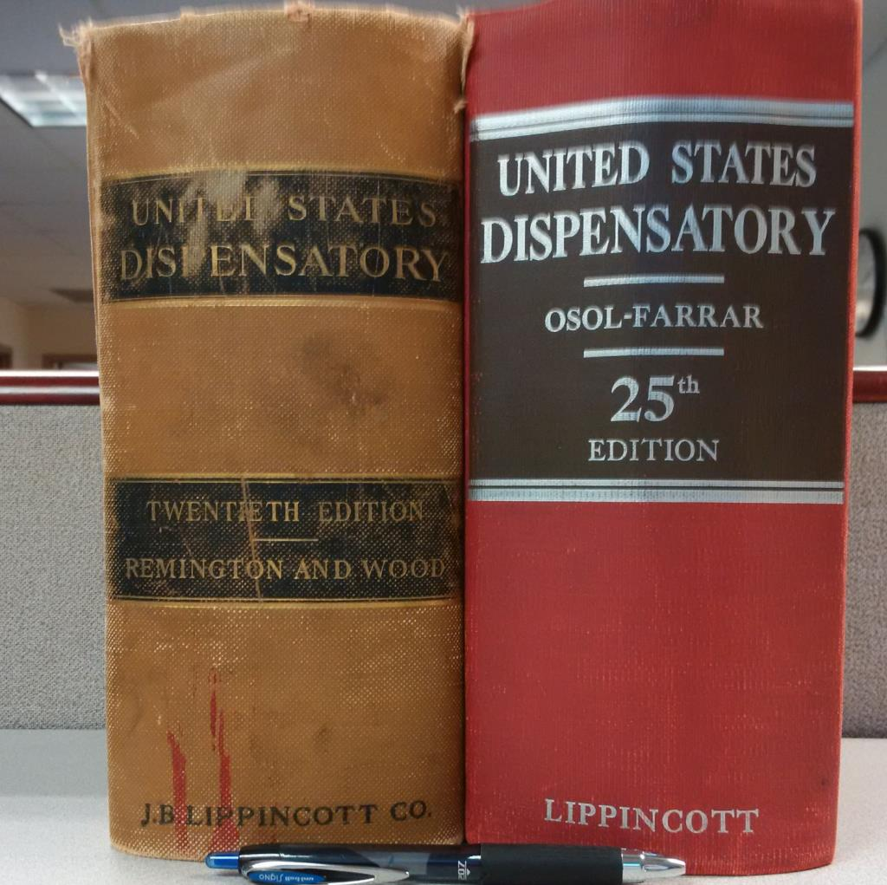
US Dispensatory

Slide 7
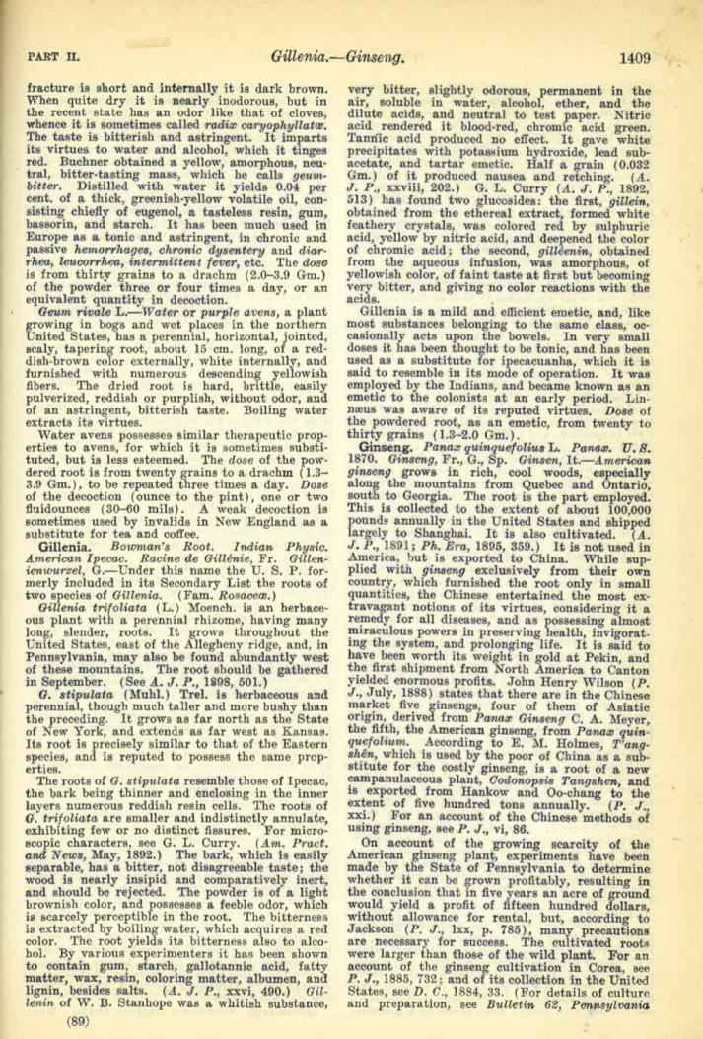
Ginseng

Slide 8
“The extraordinary medicinal virtues formerly ascribed to ginseng had no other existence than in the imagination of the Chinese. It is little more than a demulcent, and in this country is rarely employed as a medicine. Some persons, however, are in the habit of chewing it, having acquired a relish for its taste, and it is sold chiefly to supply the wants of these.” -USD 20th Edition (1918), p. 1410

Slide 9
Betz et al. (1993) J Pharm Sci 83:649-653

Slide 10
Gas Chromatographic Determination of Yohimbine in Commercial Yohimbe Products

Slide 11
Yohimbine Content of Yohimbe Products

Slide 12
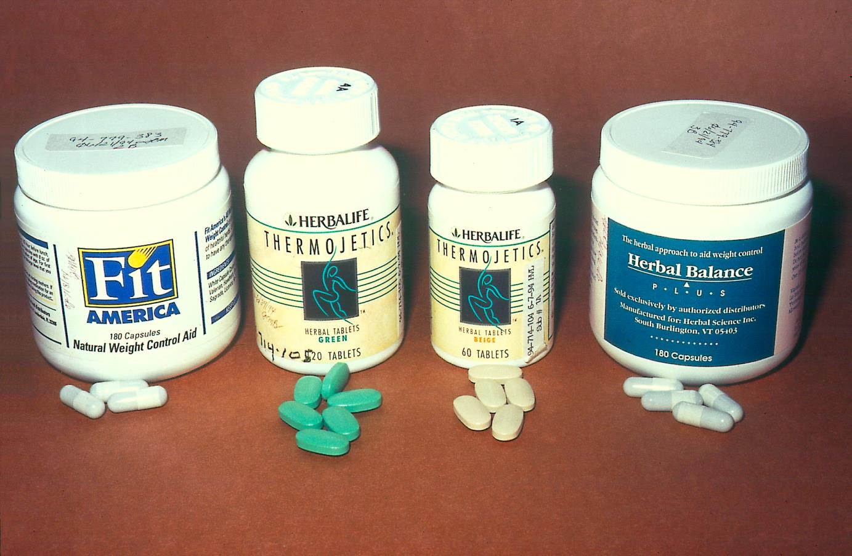
Supplements

Slide 13
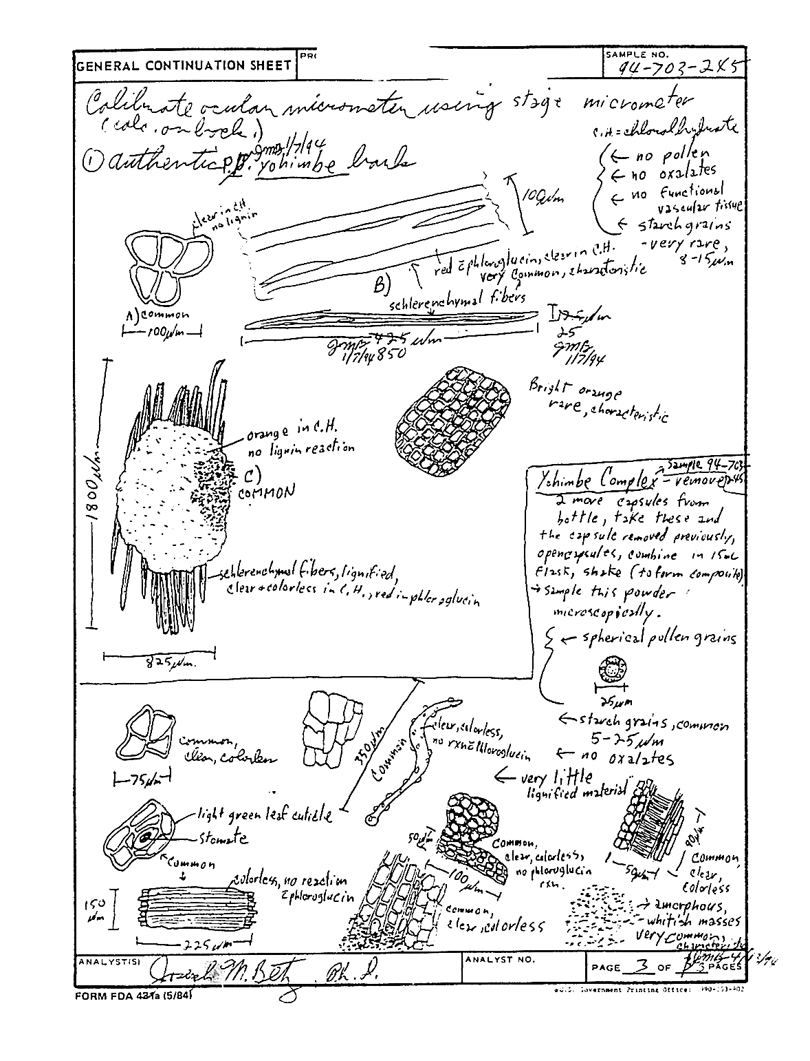
Form FDA 431a (Analyst Worksheet) depicting a drawing of Yohimbe plant material

