Slide 1
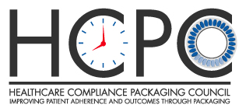
Improving Medication Adherence through Innovative Packaging:
A History of Success
Walt Berghahn
Executive Director
The Healthcare Compliance Packaging Council
Adjunct Professor, Pharmaceutical Packaging, Rutgers Engineering

Slide 2
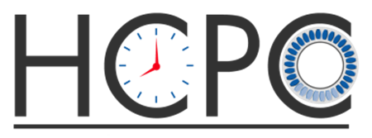
Healthcare Compliance Packaging Council
Mission: To advance the use of compliance-prompting packaging to improve medication adherence, patient safety and patient health outcomes

Slide 3
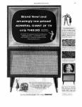
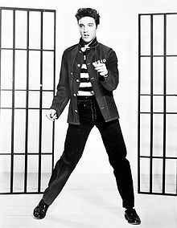
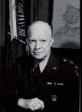
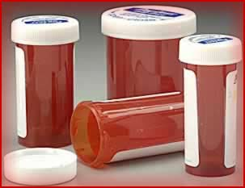
1955

Slide 4
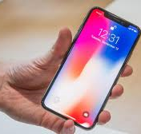
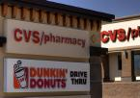
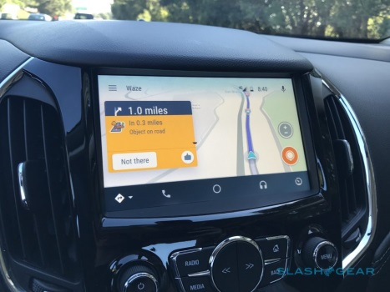
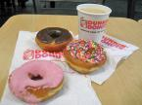
2017
62 years of evolution

Slide 5
Can pharmaceutical packaging help with the opioid epidemic?
The short answer is YES but different package features can address different aspects of the problem:
Which do we need ? Where do we need them?
Help track dosing times
Help with unintentional overdosing
Help communicate between patient and caregiver
Help track when doses go missing (theft)
Help protect doses from environment (stability)
Help detect counterfeit or gray market product
Under DSCSA with serialized packs

Slide 6
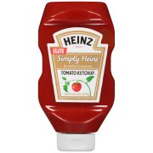
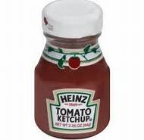
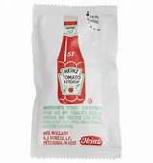
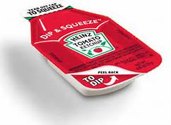
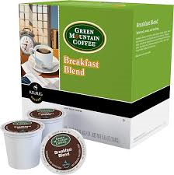
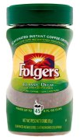
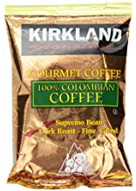
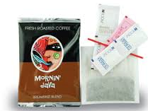
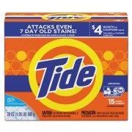
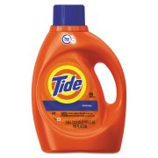
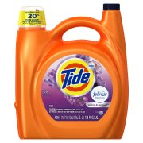
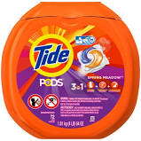
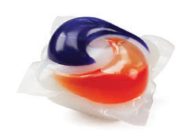
Unit of use, functional commodity packaging
Re-engineered packaging for commodity products, same need for pharmaceuticals

Slide 7
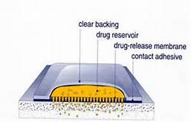
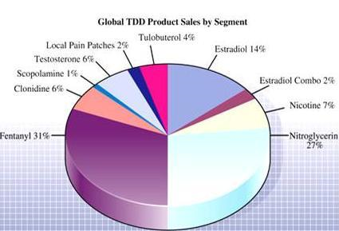
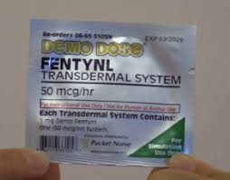
Functional medical packaging: Transdermals
Nicotine
Fentanyl
Morphine
Birth Control
Scopolamine

Slide 8
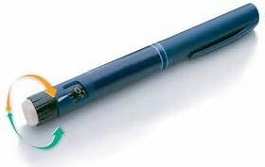
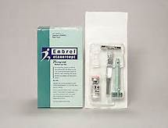
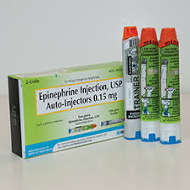
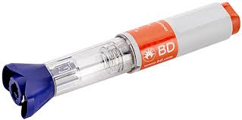
Functional medical packaging: Auto-injectors, injector pens, kits
Insulin
Epinephrine
Humira (psoriasis)
Enbrel (rheumatoid arthritis)
Lovenox (anti-coagulent)

Slide 9
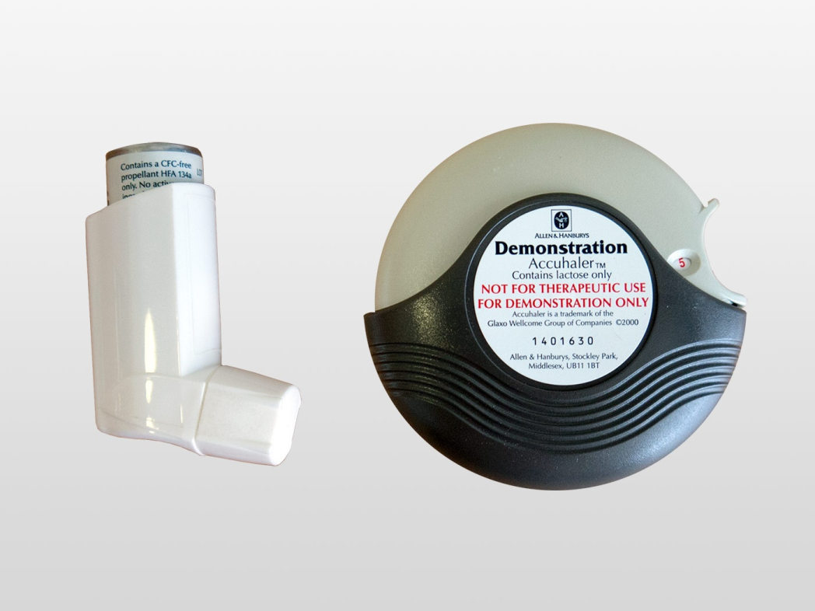
Functional medical packaging: Inhalers
Bronchitis
Asthma
COPD
Emphysema
Diabetes (developing)

Slide 10
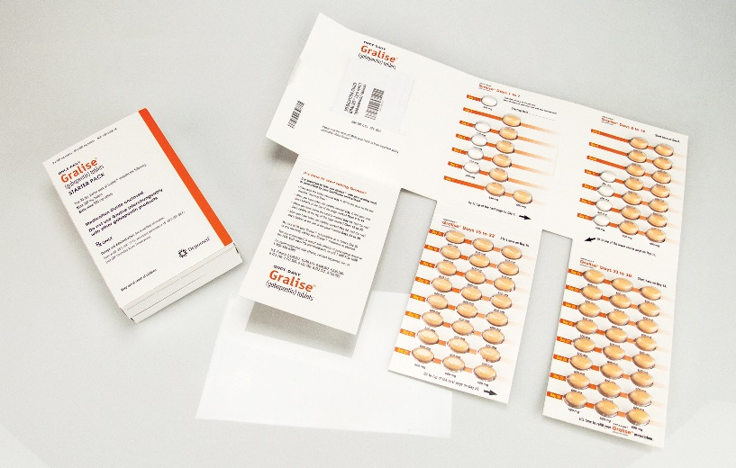
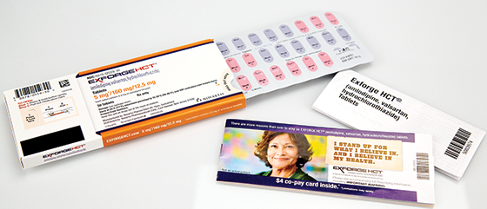
Functional pharmaceutical packaging: Solid dose
Compliance Prompting Packaging can offer visual confirmation of daily doses taken
For the patient and the caregiver
Reminder of disease being treated
Reminder of why this drug is important
All passive features but critical communication

Slide 11
U.S. Institutes of Medicine (IoM), National Academy of Sciences, Preventing Medication Errors, August 2006
Page 250: “ The strategy of using calendar blister packs could help large numbers of patients (including seniors, children, and those challenged by cognitive, physical or functional impairment) take their medication more reliably and safely, and enhance their treatment outcomes.”

Slide 12
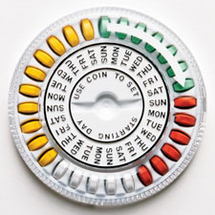
Must be some great new idea, these calendar packs, right ?
Original CPP Birth control compact (circa 1960)
Over 95% compliance
+ 7!

Slide 13
Recent Published Reviews of Packaging Adherence Studies
Interventional tools to improve medication adherence: review of literature¹
All 17 studies showed that reminder in any variation and reminder packaging have a positive impact on medication adherence and often also on clinical result.
Packaging interventions to increase medication adherence: systematic review and meta-analysis²
Data were synthesized across 22,858 subjects from 52 reports. Reviewers found that interventions were most effective when blister packs were used and delivered in pharmacies.
¹Dovepress 14 September 2015 Volume 2015:9 Pages 1303—1314
²Journal Current Medical Research and Opinion, Pages 145-160, Published online: 04 Nov 2014

Slide 14
Modulus, Inc. Hormone Replacement Therapy*(HRT)
Two groups of 50 women
Each given two prescriptions
Estrogen & Progesterone
Control group = amber vials, one for each Rx
Research group = compliance prompting blister card housing both medications
Results:
Control group compliance = 30%
Research group compliance = 82%
* MATURITAS,September 1984, the International Journal for the Study of the Climacteric

Slide 15
Unit Dose Packaging and Elderly Patient Compliance*
84 elderly patients
Research group = 45 using compliance-prompting blister packs
Control group = 39 using amber vials
Compliance rates at discharge
86.7%/Research v. 66.7%/Control
Compliance rates at 10 days
68.8%/Research v. 41.0%/Control
Compliance rates at one month
64.4%/Research v. 38.5%/Control
Compliance rates at three months
48.9%/Research v. 23.1%/Control
* Unit-of-Use – Contemporary Issues Open Conference, Baltimore, Maryland, December 13-15, 1992

Slide 16
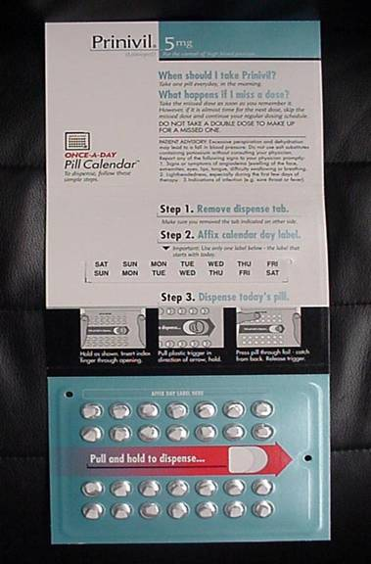
“Impact of Innovative Packaging on Adherence and Treatment Outcome in Elderly Patients with Hypertension”*
Conducted by Ohio State University
88 adults, all 65+ years of age
All had BP reading of at least 140/90
48 participants received Prinivil in blister packs with compliance-prompting features
40 received Prinivil in traditional pharmacy vials
All patients tracked for 12 months
* Journal of the American Pharmacists Association, Jan/Feb 2008, 48:1 pp. 58-63

Slide 17
Ohio State University Study
Final results
Percent on-time refill
Control group = 66.1%
Study group = 80.4%
Change in blood pressure
DBP/Control = 17% saw improvement
DBP/Study = 50% saw improvement
SBP/Control = 40% saw improvement
SBP/Study = 57% saw improvement
Conclusions:
Patients in the study group had better adherence as measured by: 1) Significantly more likely to refill prescriptions on time; and 2) Medication possession ratios significantly higher for study group (MRP = “proportion of days a patient has medication available to be taken”)
“At 12 months, a significantly greater proportion of patients in the study group had lower diastolic blood pressure (compared to baseline) than patients in the control group”

Slide 18
“Effect of Value-Added Utilities in Promoting Prescription Refill Compliance Among Patients with Hypertension”*
128 hypertensive patients monitored for one year
Interventions & compliance rates:
Control (no intervention) = 0.64
Reminder card = 0.71
Compliance-prompting package = 0.75
Packaging & reminder = 0.87
*Current Therapeutic Research, Vol. 53, No. 3, March, 1993
Key take away: Multiple tools work better than any single tool

Slide 19
Novartis Diovan®HCT Study
Patients with reminder packaging had an 80% medication possession ratio vs. 73% for those using standard pharmacy packaging resulting in 13% higher proportion of days covered.
Patients using the Diovan HCT reminder pack refilled their prescriptions 4 days earlier on average
This is a similar rate to the previous Ohio State study where 48% vs 20% had improvement in BP during the study.
Real-world impact of reminder packaging on antihypertensive treatment adherence and persistence, Patient Preference and Adherence 2012:6

Slide 20
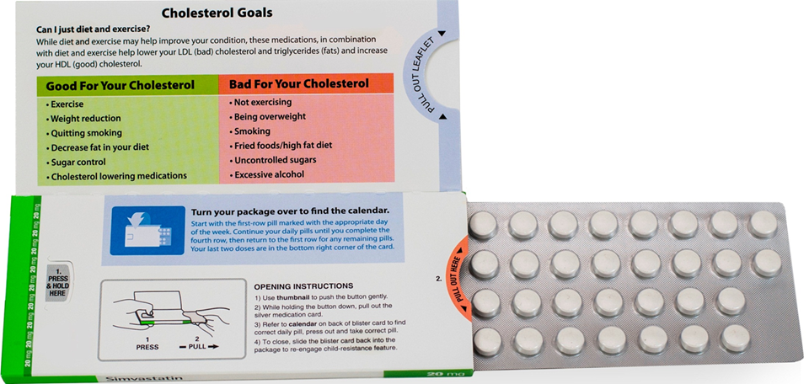
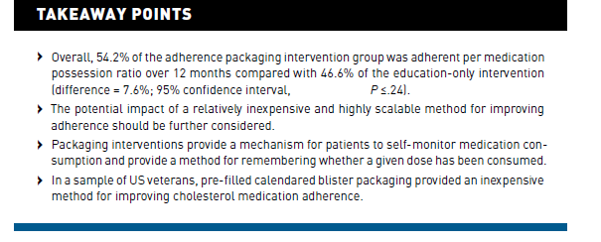
Recent VA Study on Compliance Packaging for Statins
Evaluation of a Packaging Approach to Improve Cholesterol Medication Adherence, Am J Manag Care. 2017;23(9):e280-e286

Slide 21
Example: IMC
“With blister medication packages, you have a lot of real estate to work with in terms of the graphics and for us to hide the electronics,” he noted. “With medication packaging, the more sophisticated packaging surrounds the blister with cardboard, which is very suitable for printed electronics to detect each dose being taken from each package, as well as hiding traditional electronics in the structure. However, on our smart bottle caps, we have no opportunity to use printed electronics.”

Slide 22
The Med-ic® Electronic Compliance Monitor (ECM©) utilizes a CPU and attached printed sensor grid embedded in a medication blister package. The CPU records the time when a given tablet or capsule is expelled from its blister, and stores the data for later display and/or analysis. At the time of refilling the prescription or during a clinical trial follow-up visit, the patient's compliance data are downloaded to a PC via a CertiScan® RFID Reader, or downloaded using any NFC-enabled smart phone or tablet.

Slide 23
How can packaging features address the opioid epidemic?
Provide visibility of opioid use and abuse
Billboard messaging, educate about risks of addiction
Creating space for self-recording of dispense events for patient and caregiver
Couple with apps for tracking each dispense event
Digital recording of dispense events via NFC, RFID
Capture missing doses (pilferage in the pharmacy/home)
Contribute to pharmaceutical safety by impacting multiple areas of the supply chain

Slide 24
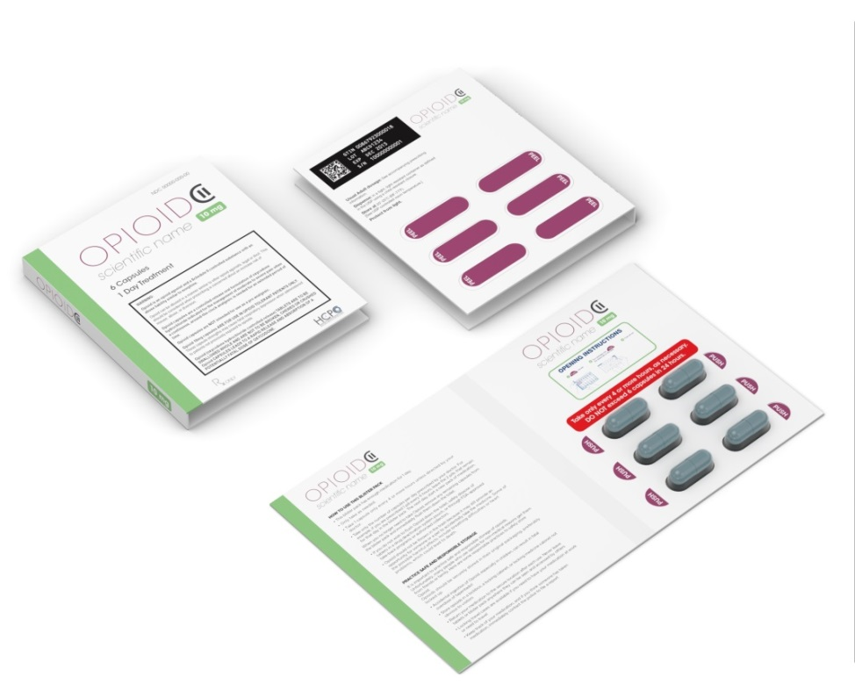
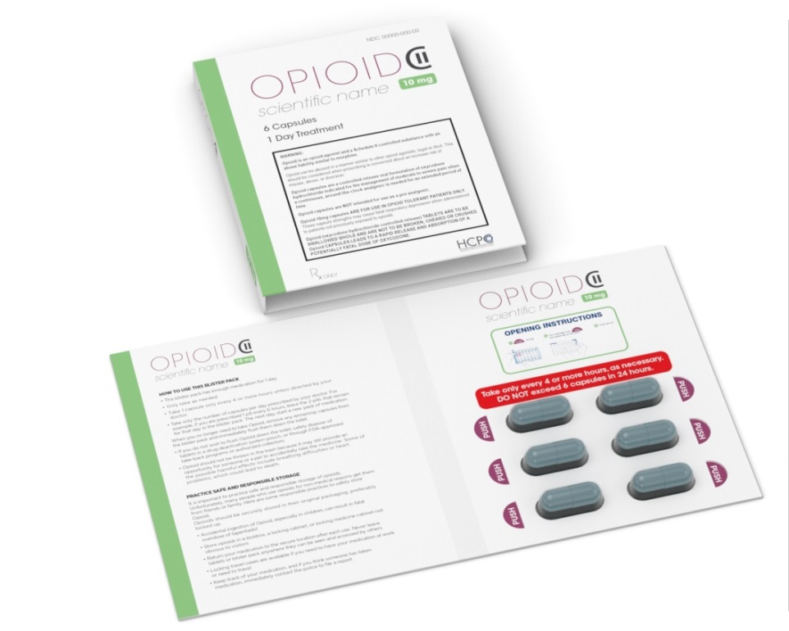
Conceptual Opioid Packaging
Typical chronic compliance packaging is geared toward maintaining regular dosing
In opioid scenario – we’re attempting to prevent unintentional overdosing
Simple package can have patient or caregiver record when doses are taken
Packaging design compliments of HCPC Member, PCI Pharma Services

Slide 25
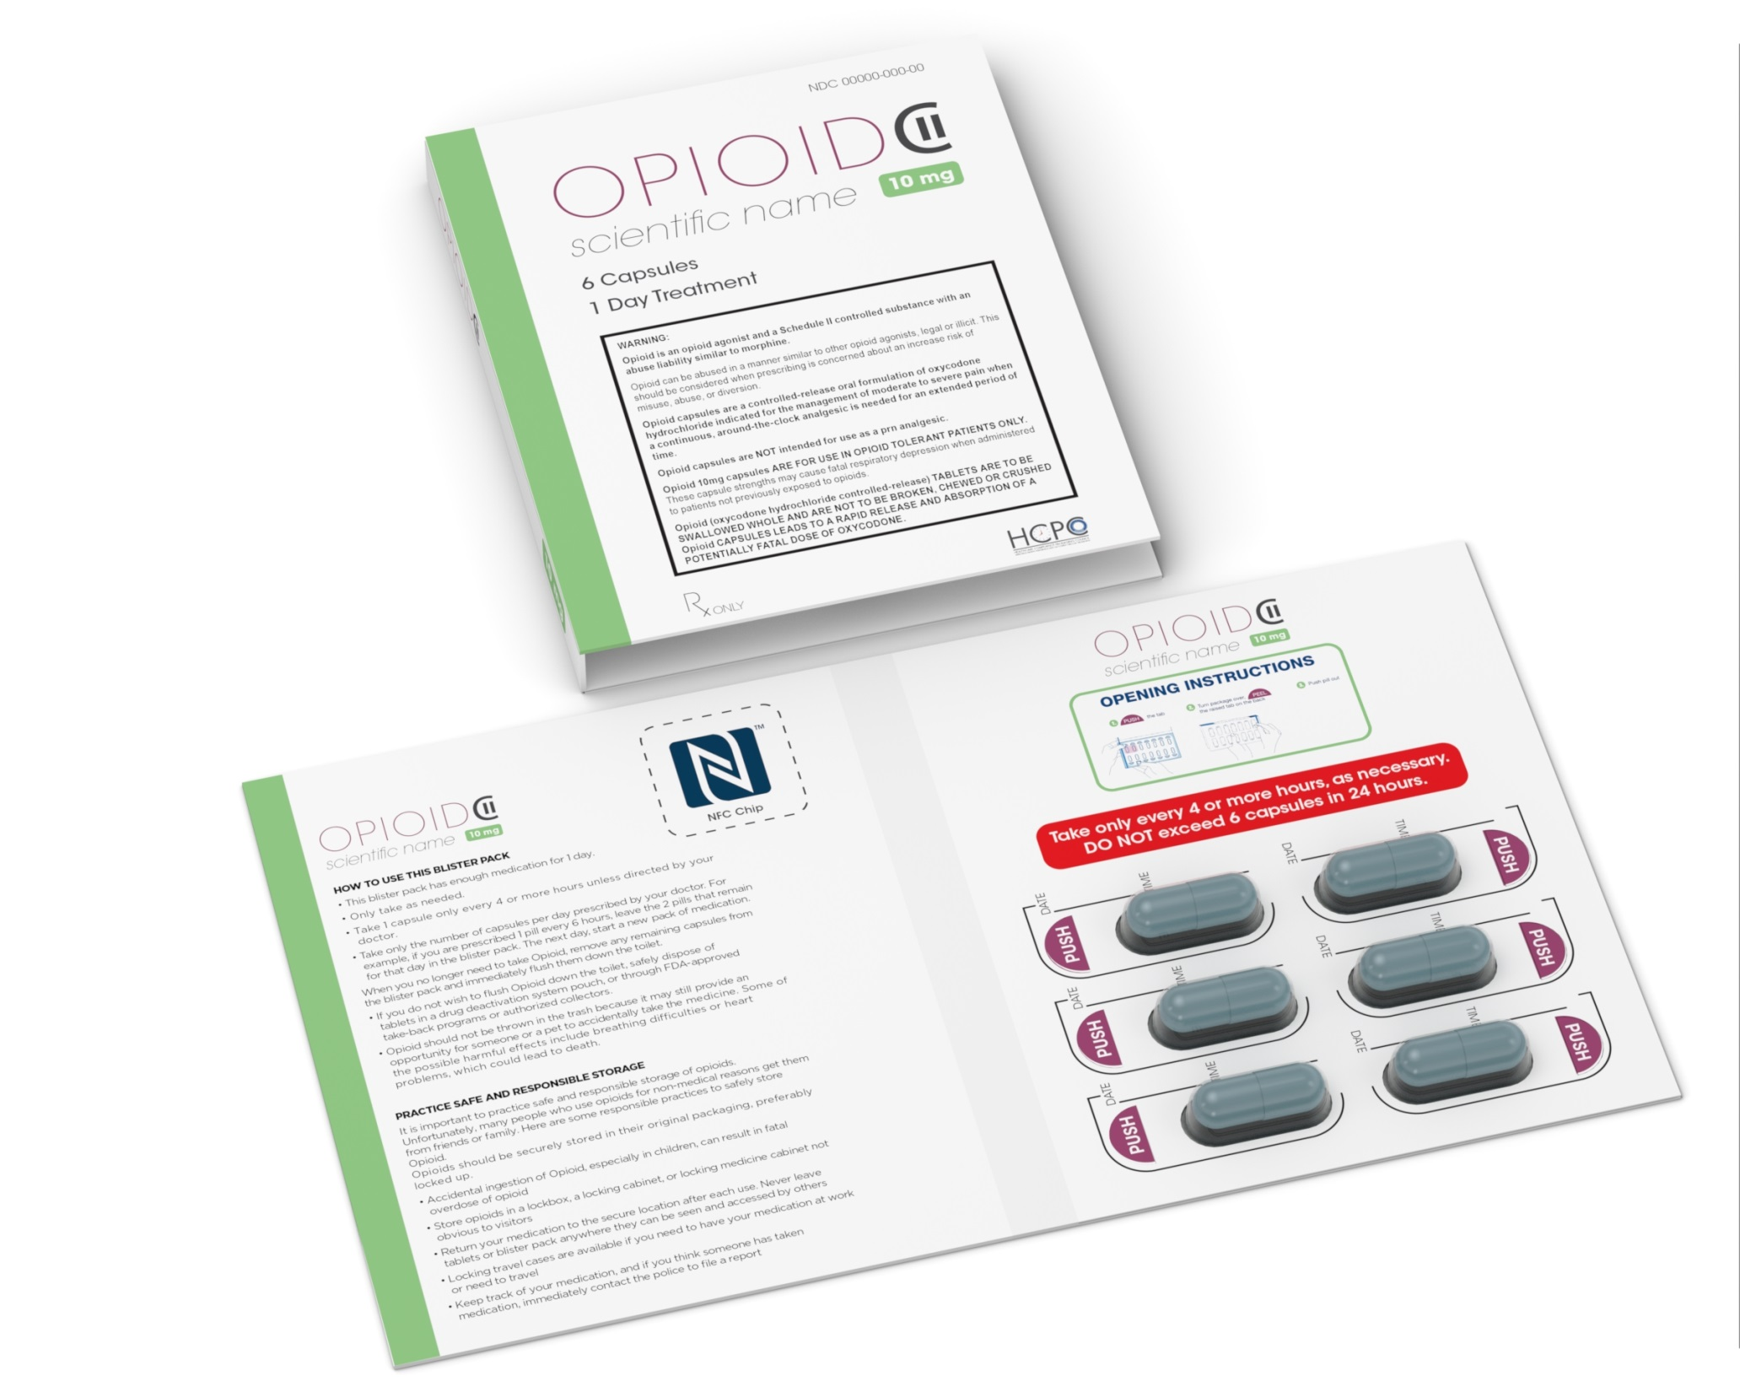
Theoretical Single or Multi-day blister for short acting opioid pain reliever
Simple option: Include space for recording doses taken
Include chip or NFC label to digitally record access and report back to pharmacist, physician

Slide 26
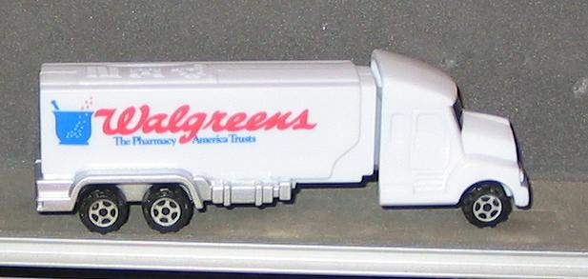
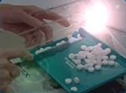
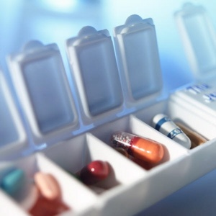
Beyond the Patient: Safe and Secure Supply Chain?
Safe delivery to the pharmacy, yes !
Safe delivery to the patient?
Safe storage by the patient?
Proper use by the patient?
(*not an actual Walgreen’s truck!)

Slide 27
Questions?
Walter Berghahn
Executive Director
The Healthcare Compliance Packaging Council
Adjunct Professor, Rutgers, Pharmaceutical Packaging
603-520-7729
walterberghahn@yahoo.com
www.hcpconline.org

