Slide 1
Lifting the Limits on Innovation to Support Real-Time Improvements in Public Health
FDA Public Hearing
July 26, 2018
Dr. Robert C. Post, Senior Director

Slide 2
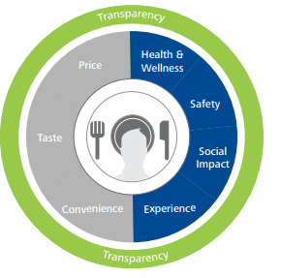
Innovation Means Health and Wellness for All
Challenge
Opportunity
Health is important to consumers, but so are safety, naturality, and lifestyle beliefs.
Make health and wellness universal by embracing a comprehensive and integrated approach, in the communities where we operate and the nation as a whole.
Align nutrition science, good business practices, and consumer values into innovation.
-LIFESTYLE NUTRITION
-LIFE-STAGE NEEDS
-SUSTAINABILTY
-ENVIRONMENTAL STEWARDSHIP
-FOOD WASTE
-FAIR TRADE
-ACCESSIBILITY
-VARIETY
-CHOICE
-JOY
-FULFILLMENT
-PERSONALIZATION

Slide 3
Standards of Identity (SOI)
Challenge
Opportunity
SOIs have not kept pace with the array of products in the marketplace, which inhibits the development and recognition of new nutrient-dense products.
Innovation has created newer mainstream products, which align with the Dietary Guidelines, that are not reflected by SOI today.
Create standards for product categories of new / prominent products in the marketplace.
Distinguish between imitation and authentic products to avoid confusion / unintended public health consequences.
Inability to use salt substitutes.
Inhibits sodium reduction.
No SOI for strained, high-protein yogurt.
Prevents protein superiority from being equitably credited in school meals.
Reduced-Salt Cheese
Strained, High-Protein Yogurt

Slide 4
A Case Study: Without SOI, Foods Aren’t Credited Equally
 | Greek Yogurt | Beef Patty | Kidney Beans | Peas | Mozzarella Cheese | Peanut Butter | Egg | Tofu | Chicken Patty | Great Northern Beans
Serving Size | 4oz | 2oz | 1/2 cup | 1/2 cup | 2oz | 4 tbsp. | 1 egg | 1/2 cup | 2oz | 1/2 cup
Protein | 9g | 14g | 7g | 3.5g | 14g | 14g | 6g | 10g | 9g | 7g
PDCAAS Score | 1 | 1 | 0.81 | 0.88 | 1 | 0.95 | 1 | 0.91 | 0.95 | 0.81
Iron | 0.14 mg | 1.63 mg | 1.5 mg | 1 mg | 0.13 mg | 1.38 mg | 0.88 mg | 2 mg | 0.57 mg | 1.89 mg
Niacin | 0.24 mg | 1.88 mg | 0.52 mg | 1.1 mg | 0.08 mg | 8.42 mg | 0.03 mg | 0.12 mg | 2.8 mg | 0.6 mg
Crediting | 1 M/MA | 2 M/MA | 2 M/MA | 2 M/MA | 2 M/MA | 2 M/MA | 2 M/MA | 2 M/MA | 2 M/MA | 2 M/MA
Strained, high-protein yogurts are equivalent or superior in essential nutrients (e.g., calcium and potassium) compared to other foods receiving 2 M/MA credits.
Despite availability and acceptability of strained, high-protein yogurts, without a SOI, these products have been often overlooked because other protein foods have higher crediting values.

Slide 5
Claims: “Healthy”
Challenge
Opportunity
Consumers can benefit from guidance towards healthier choices. But the FDA “healthy” definition is outdated – meaning products that align with the latest nutrition science understanding may not use it.
Criteria must be science-based and category-specific to support truly healthful food / ingredient innovations.
Low-fat
yogurt
Raisins
Low-fat
yogurt
Raisins
Doesn’t meet current definition of “healthy” yet is recommended in the Dietary Guidelines
Outdated cholesterol
criteria
Less than required RDI or DRV per RA for all nutrients
High-quality protein option, recognized as part of a healthy eating pattern
No cholesterol limit, recognized as part of a healthy eating pattern
Widely acceptable, nutrient-dense option recognized as part of a healthy eating pattern
“Healthy” needs to be a descriptive term for recommended food groups and dietary patterns – not prescriptive nutrients – to align with dietary guidance.

Slide 6
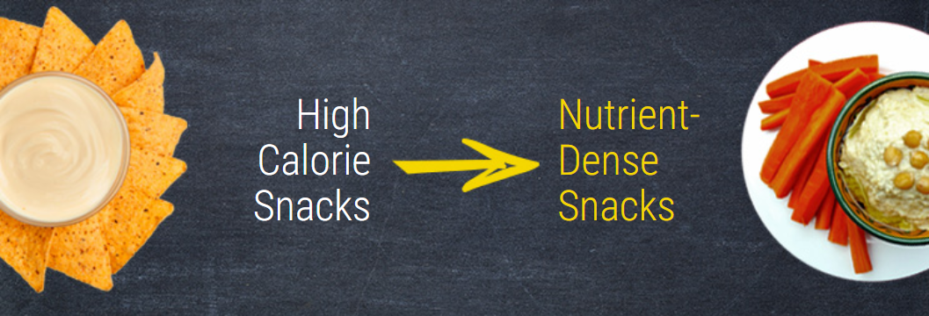
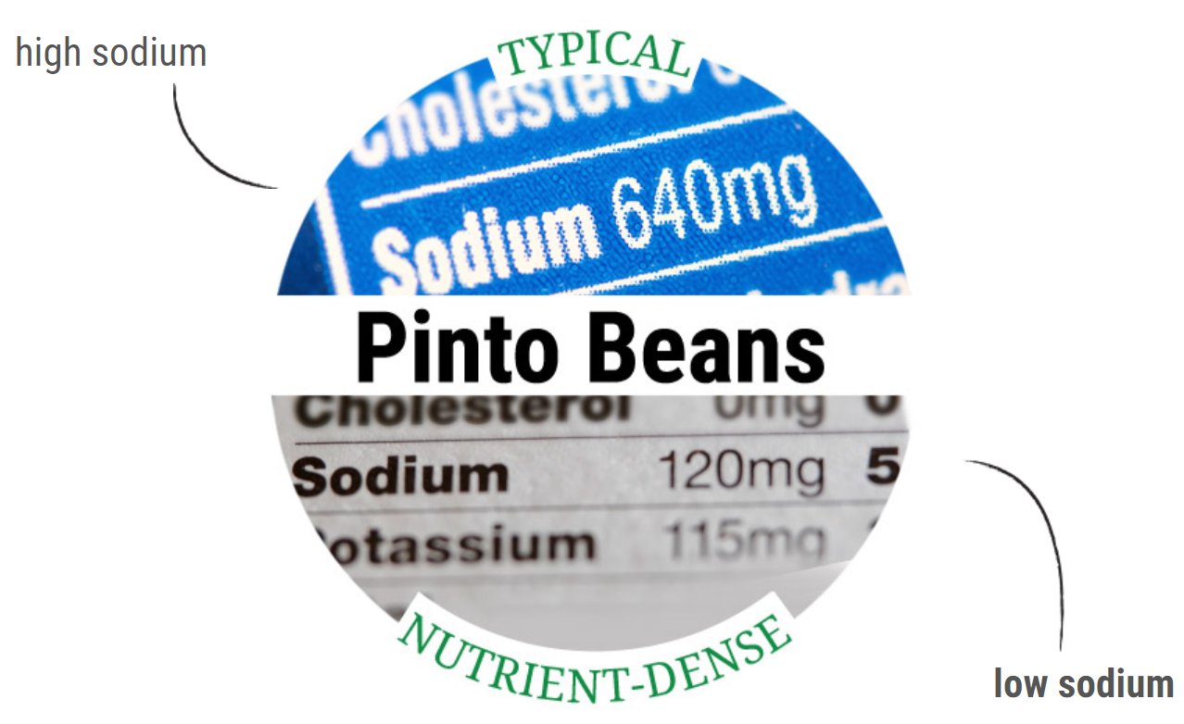
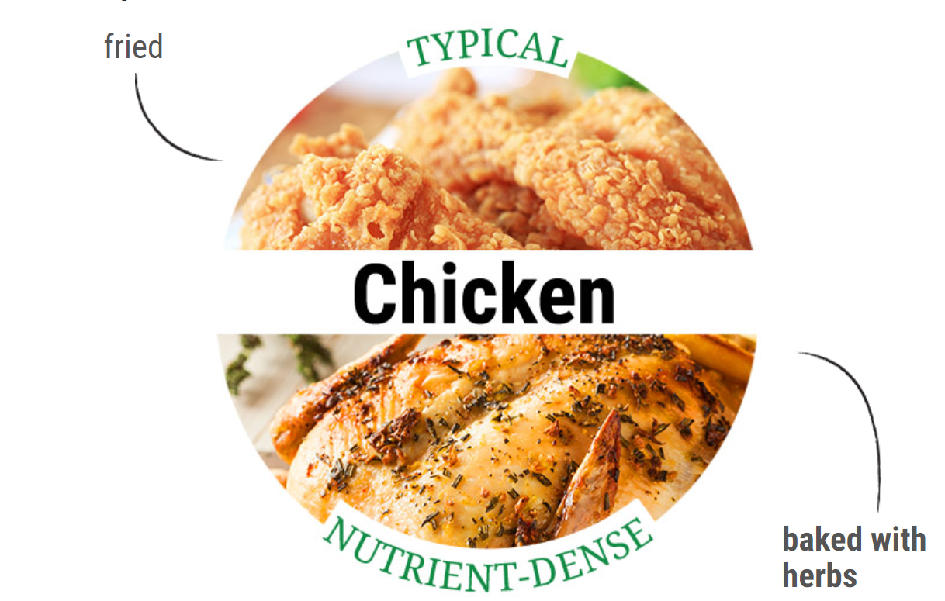
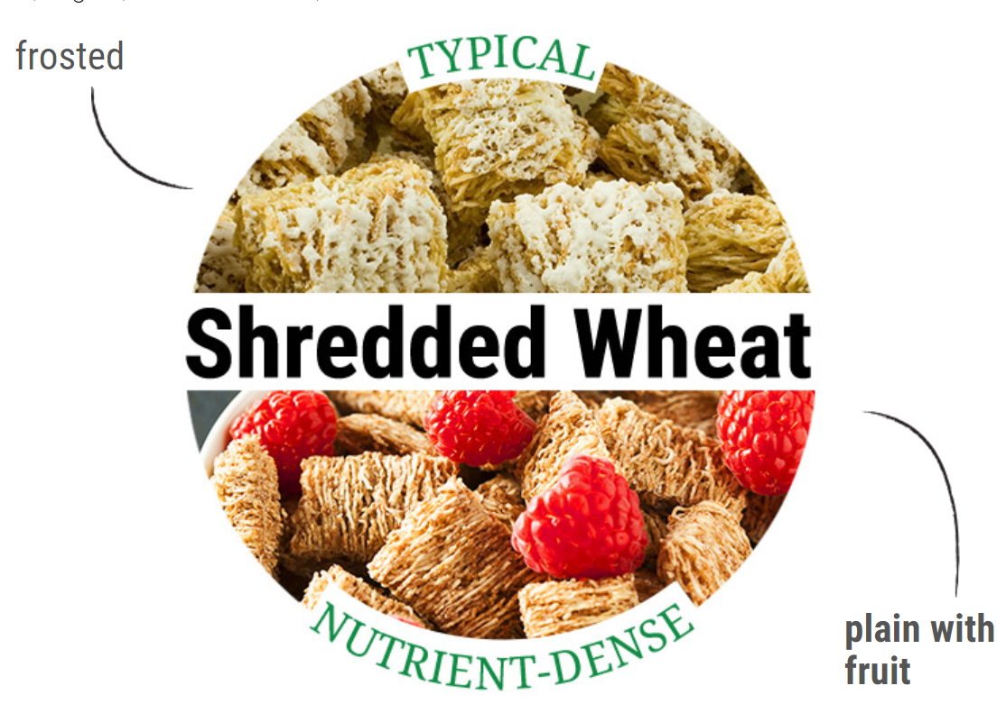
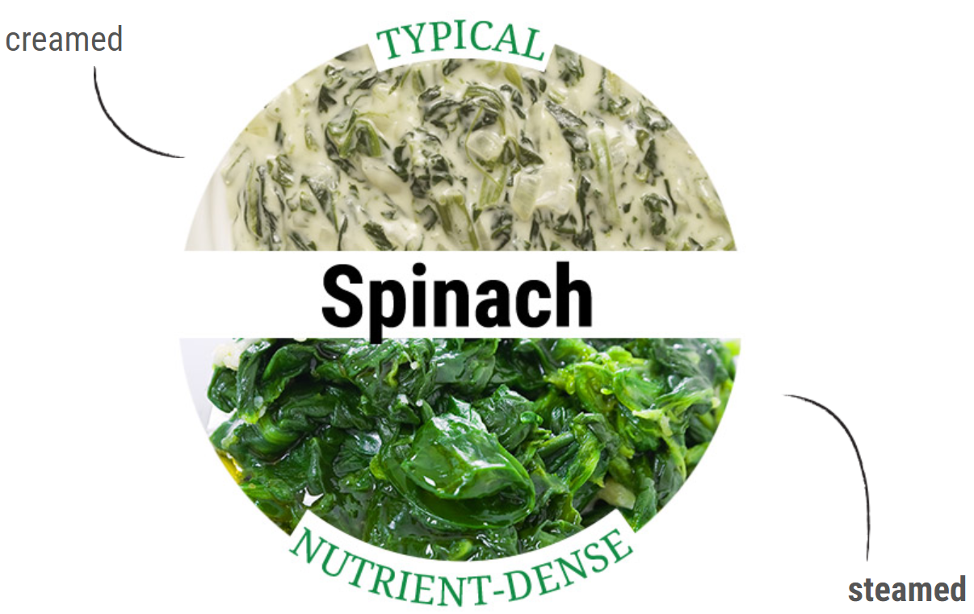
Claims: “Nutrient-Dense”
Challenge
Opportunity
Shifting to nutrient-dense choices is a core dietary recommendation. This requires some way to judge a food’s contributions to healthy eating patterns – but no such definition yet exists to guide product development.
Define nutrient density via criteria for food categories to give manufacturers a guide for developing / communicating around nutrient-dense options, aligned with the Dietary Guidelines.
Fruit punch
Greek Yogurt
Drink
Strawberry ice cream
Strained, high-protein yogurt
(Greek Yogurt)

Slide 7
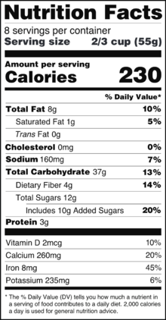
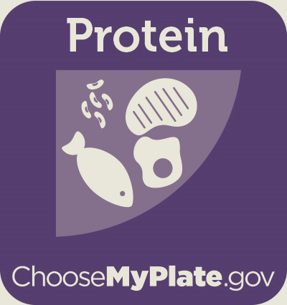
Nutrition Labeling Education
Challenge
Opportunity
Consumers primarily use the Nutrition Facts label to identify nutrients to limit – not overall nutritional quality. With the new Nutrition Facts label, misinterpretation of new label elements, such as added sugars, may occur.
Teach consumers how to evaluate the full nutritional profile of products to prevent them from disregarding nutritious / healthful products based on one or two ingredients / nutrients.
3 in 4 consumers
would choose to buy products without added sugars on the label.
Choose foods/ beverages in the context of contributions to total diet and lifecycle/life-stage needs.
+

Slide 8
Thank you
Robert.Post@Chobani.com
www.Chobani.com

