Slide 1
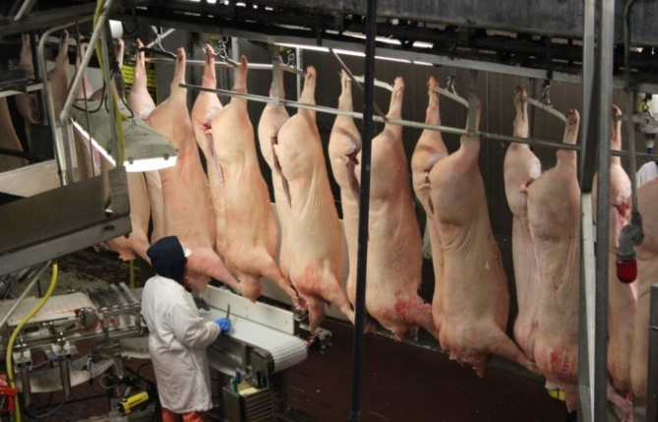
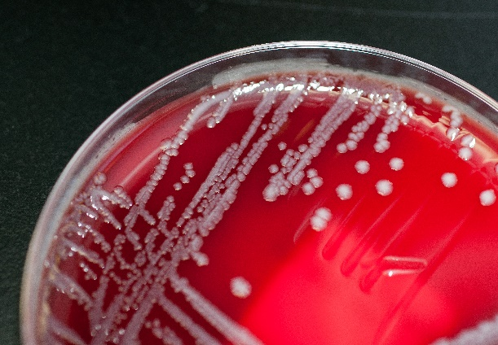
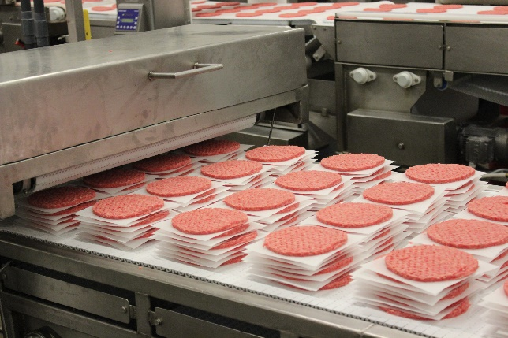
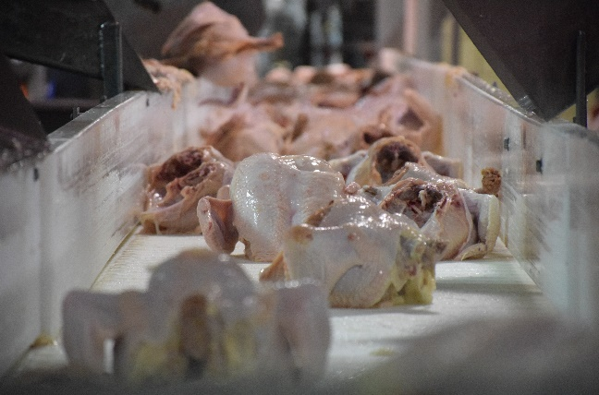
Office of Food Safety
Protecting Public Health and Preventing Foodborne Illness

Slide 2
U.S. Food and Drug Administration Public Meeting:
A New Era of Smarter Food Safety
Food Safety Policies: Smart and Modern
October 21, 2019
Rockville, Maryland
Mindy Brashears, Ph.D.
Deputy Under Secretary for Food Safety
U.S. Department of Agriculture

Slide 3
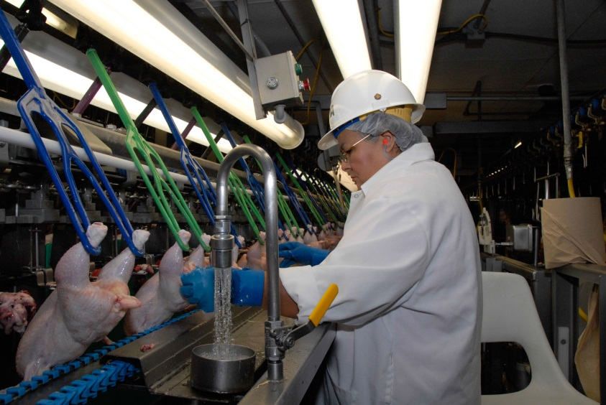
USDA-FSIS: Who We Are
We are the public health agency in the USDA that is responsible for ensuring meat, poultry, and processed egg products are safe, wholesome, and accurately labeled.
Federal Meat Inspection Act (FMIA), 1906
Egg Products Inspection Act (EPIA), 1970
Humane Methods of Slaughter Act (HMSA), 1958
Poultry Products Inspection Act (PPIA), 1957
Our Authority
Through a series of Acts, Congress empowers FSIS to inspect all meat, poultry, and processed egg products in interstate commerce.

Slide 4
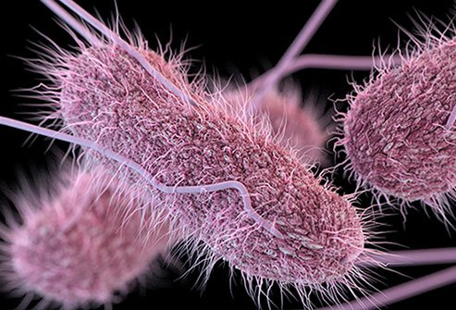
Research+
Technology+
Innovation=
“Smart and Modern”
Policies
Regulations should keep up with the Science!

Slide 5
Science Drives FSIS’ Decisions
Modernized Inspection
Performance Standards
Consumer Education

Slide 6
FSIS’ MODERNIZATION EFFORTS
Decrease inefficiencies
Focus on science-based enhancements
Focus on off-line inspection tasks
(HACCP, Sanitation)
100% on-line inspection continues
Informed by 20 years of pilot studies

Slide 7
Performance Standards:
Poultry, Pork, and Beef
Risk Assessment Data Inputs
Baseline Prevalence Data in Product
Human Illness Attribution Data
Goal
Reduce illness (HP2020 goal)
Output
Performance Standards

Slide 8
“Smarter”
Consumer Education
USDA AND FDA ARE WORKING TOGETHER

Slide 9
APPLYING WISDOM…
Data alone do not tell the full story.
EXAMPLE:
“FSIS funded a study where the use of a video intervention improved handwashing behavior in research subjects preparing raw poultry”
The statement is true…
BUT, the actual data tell the real story…

Slide 10
Handwashing Before Meal Preparation
* Differences between groups for successful handwashing statistically significant at p = .0168

Slide 11
Do Right and Feed Everyone…Safely!

