Slide 1
Methylated DNA adducts in humans
Data on environmentally exposed humans are limited
Only 3 relatively large population studies, all conducted in the context of mother-child cohorts in Greek women (Georgiadis et al., CEBP 2000 & 2011; Merlo et al., EHP 2014)
Based on a total of 685 (out of 1021) samples with detectable levels,
O⁶-meG mean = 16 attomol/μg DNA* (range 4.5 – 109)
* 27 mol/10⁸ molG; ~59 molecules per diploid cell

Slide 2
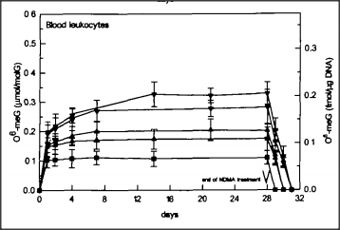
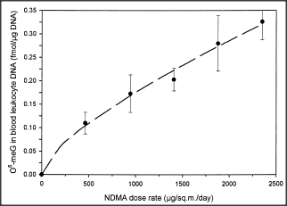
O⁶-meG in blood DNA after NDMA (rats, drinking water)
Souliotis et al, Carcinogenesis 1995
0.52-2.64 ppm NDMA, 28 days
upper limit
of human O⁶-meG
0 4 8 12 16 20 24 28
exposure period (days)
0 500 1000 1500 2000
NDMA dose rate (μg/sq.m. per day)
NDMA exposure corresponding to O⁶-meG levels observed in humans:
mean: 144 μg/day
max.: 982 μg/day
Estimates by Hrudey et al., Risk Anal. 33 (2013) 2179
based on μg/day
NDMA in blood mean: 900
urinary excretion <250-6,400

Slide 3
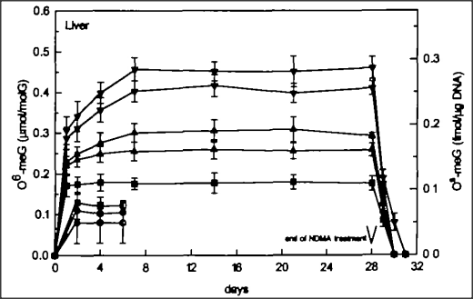
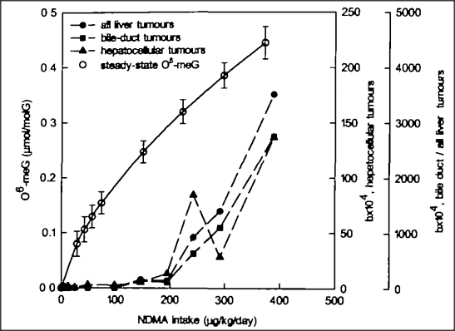
NDMA-induced Ο⁶-meG and carcinogenesis in rat liver
O⁶-meG in liver DNA; NDMA in dr. water
O⁶-meG
Weibul
index
cell proliferation
days
NDMA dose rate (μg/kg per day)

Slide 4
NDMA-induced O⁶-meG in different tissues in rats and patas monkeys
Anderson et al., Int.J.Canc. 1996
100 μg/kg NDMA, p.o., 4h
blood leukocytes
blood leukocytes
uterus
rats
patas monkeys
pancreas
bladder
bladder
large bowel
stomach
esophagus
esophagus
lung
liver
liver

