Slide 1
Biosimilars and Interchangeable Biosimilars
Regulatory and Scientific Concepts
Level 2

Slide 2
Contents
Biological Product Complexity
Biosimilar Inherent Variation
Consistency in Manufacturing and Analytical Assessments
Biological Product Approval Pathways
Different Approval Pathways for Reference Products and Biosimilar Products
Biosimilar Manufacturers Must Demonstrate Biosimilarity to the Reference Product
Clinical Studies to Address Residual Uncertainty
Clinical Studies to Demonstrate Similar Exposure, Efficacy, and Safety
Comparative Analytical Assessment
Comparative Analytical Assessment: The Foundation of the 351(k) Pathway
Identification and Measurement of Product Quality Attributes
Characterizing Quality Attributes of the Reference and Biosimilar Product
Evaluation of Biosimilarity Using a Totality-of-the-Evidence Approach
Comparative Analytical Assessment and Product Quality
Analytical Studies are the Foundation of the 351(k) Pathway
Identification of Product Quality Attributes
Critical Quality Attributes Example: Insulin Products
Illustrative Critical Quality Attribute: Post-Translational Modifications
Commonly Encountered Post-Translational Modifications
Clinically Inactive Components in Demonstration of Biosimilarity
Insulins/Interchangeability
Biosimilar and Interchangeable Products in Primary Care and Community Practice: Insulins
Adoption of Biosimilars
Biosimilar Naming
Biosimilar Naming Conventions
Practical Considerations for Using Biosimilars and Interchangeable Biosimilars
Biosimilars Are as Safe and Effective as the Reference Product
Immune Response to Biologics
Biosimilars and Interchangeable Biosimilar Labeling
Resources
The Purple Book
Health Care Provider Materials
Addressing Patient Questions
FDA Biosimilar Materials in Spanish
Resources
Key Takeaways
Knowledge Assessment
Multiple Choice Questions

Slide 3
Biological Product Complexity

Slide 4
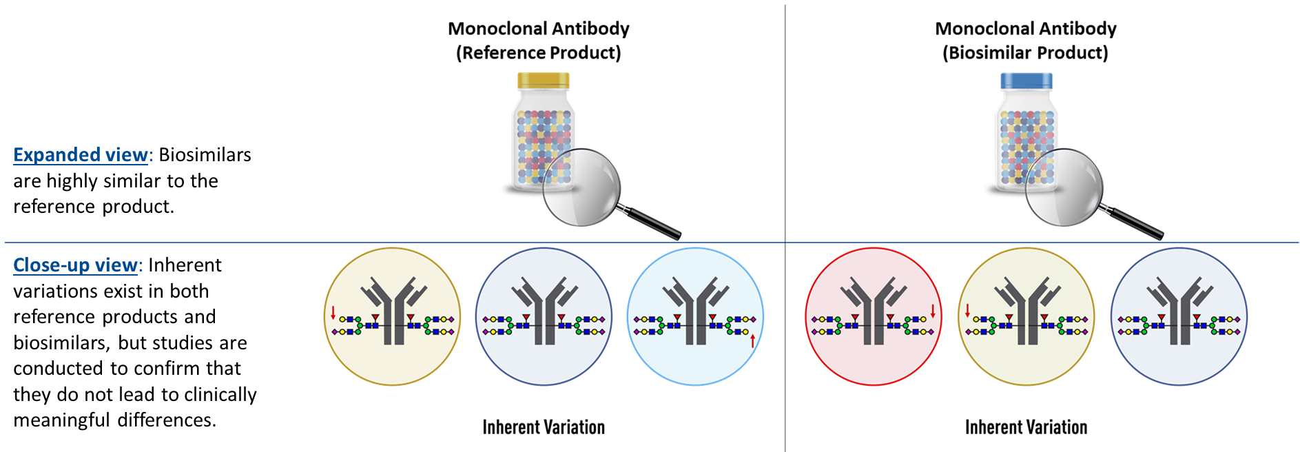
Biologics Inherent Variability
As part of the manufacturing process, different lots of biological products contain millions of slightly different versions of the same protein or antibody, called lot-to-lot variation (observed in both the reference product and biosimilar). In this example, red arrows indicate small differences in the N-glycosylation chain within a lot during the manufacturing process of both reference products and biosimilars. Identical biological variants (reference products and biosimilars) are depicted as circles with the same color.

Slide 5
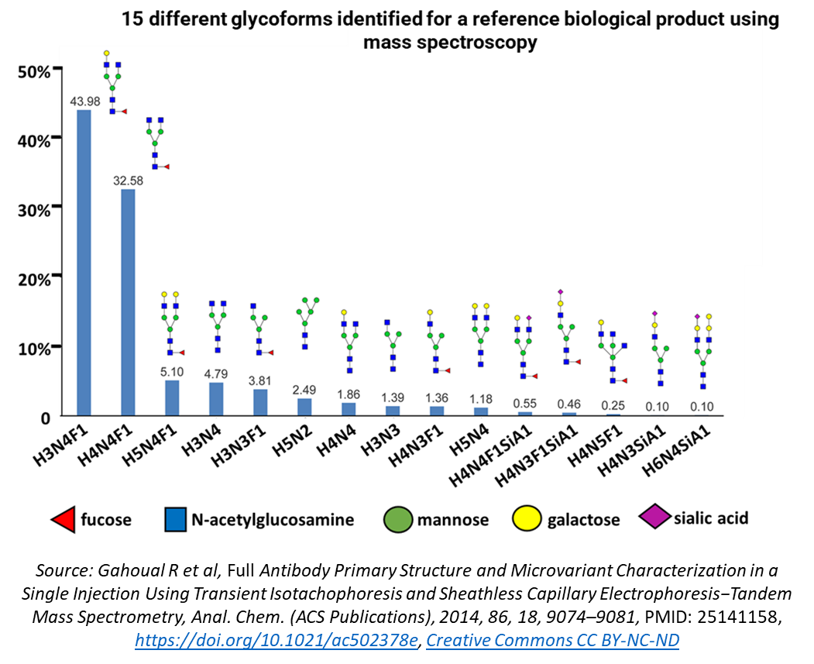
Consistency in Manufacturing and Analytical Assessments
Analytical assessment serves as the foundation for demonstrating biosimilarity:
Inherent variations occur in both reference products and biosimilars, where the same protein may have many slightly different versions in a single lot (for example, variation typically occurs in glycosylation).
Comparative analytical data are necessary to understand the heterogeneity of biologics and the ranges of variability of different forms (e.g., levels of glycosylation) and provide the foundation for biosimilar development.
As part of the approval process, FDA assesses manufacturers’ strategies to control for the pattern and degree of variations between different lots of the biological product (i.e., keep a consistent mix of variants between the lots) to help ensure consistency in safety and effectiveness.
Notes:
Additional descriptive text for graph:
Graph data:
H3N4F1 (43.98), H4N4F1 (32.58), H5N4F1 (5.10), H3N4 (4.79), H3N3F1 (3.81), H5N2 (2.49), H4N4 (1.86), H3N3 (1.39), H4N3F1 (1.36), H5N4 (1.18), H4N4F1SiA1 (0.55), H4N3F1SiA1 (0.46), H4N5F1 (0.25), H4N3SiA1 (0.10), and H6N4SiA1 (0.10).
Glycoforms consist of combinations of fucose, n-acetylglucosamine, mannose, galactose, and/or sialic acid.
Source: Gahoual R et al, Full Antibody Primary Structure and Microvariant Characterization in a Single Injection Using Transient Isotachophoresis and Sheathless Capillary Electrophoresis-Tandem Mass Spectrometry, Anal. Chem. (ACS Publications), 2014, 86, 18, 9074-9081, PMID: 25141158
https://doi.org/10.1021/ac502378e, Creative Commons CC BY-NC-ND

Slide 6
Biological Product Approval Pathways

Slide 7
Different Approval Pathways for Reference Products and Biosimilar Products
FDA approves reference products and biosimilars through different statutory approval pathways. While reference products are approved in a “standalone” application submitted through the section 351(a) pathway, biosimilars and interchangeable biosimilars are approved through the abbreviated section 351(k) pathway that is based on a comparison of the proposed biosimilar to the reference product. To demonstrate that the product is biosimilar to the reference product, 351(k) applications must include information demonstrating that the biosimilar:
Utilizes the same mechanism(s) of action for the proposed condition(s) of use - but only to the extent the mechanism(s) are known for the reference product.
Proposes condition(s) of use in labeling that have been previously approved for the reference product.
Has the same route of administration, dosage form, and strength as the reference product.
Is manufactured, processed, packed, or held in a facility that meets standards designed to assure that the biologic continues to be safe, pure, and potent.

Slide 8
Biosimilar Manufacturers Must Demonstrate Biosimilarity to the Reference Product
The approval process for a biosimilar involves an extensive structural and functional comparison to the reference product. For approval, the comparison to the reference product must demonstrate that:
The proposed biosimilar is highly similar
A demonstration supporting biosimilarity is based on comparative analytical studies to the reference product. Analytical studies form the foundation of the biosimilar approval process that is based on comparative data from:
Physicochemical assays
Functional assays
The proposed biosimilar has no clinically meaningful differences
Studies are performed to show that proposed biosimilars have no clinically meaningful differences in safety, purity, or potency (i.e., safety and effectiveness) compared to the reference product. These may include:
Comparative analytical assessments
Clinical pharmacology studies
Additional clinical studies

Slide 9
Clinical Studies to Address Residual Uncertainty
The nature and scope of the clinical study or studies will depend on the nature and extent of residual uncertainty about biosimilarity after conducting structural and functional characterization.
Human PK and PD studies comparing a proposed product to the reference product generally are fundamental components in supporting a demonstration of biosimilarity.
Treatment and Comparison | Area Under the Curve | Peak Serum Concentration
Geometric Mean
Proposed biosimilar | 30,651 h*ug/mL | 226ug/mL
Reference product | 32,160 h*ug/mL | 223ug/mL
Ratio of Geometric Means (90% Cl) (%)*
Proposed biosimilar product vs. Reference product | 95.31 (81.01 – 112.13) | 101.38 (93.49 – 109.94)
*FDA considers 80-125% as an appropriate starting point for an acceptable limit for the confidence interval (Cl) of the ratio

Slide 10
Clinical Studies to Address Residual Uncertainty
CCS: Comparative clinical study
The above comparative assessments can be conducted in one study or multiple studies.
The type and amount of study data needed will depend on the nature of the proposed product. For example, an assessment of PK similarity may not be relevant for products with minimal or no systemic exposure, or comparative immunogenicity study for products known to have minimal risk of immunogenicity clinically (e.g., insulins).

Slide 11
Clinical Studies to Demonstrate Similar Exposure, Efficacy, and Safety
Example for PK + PD + immunogenicity approach:

Slide 12
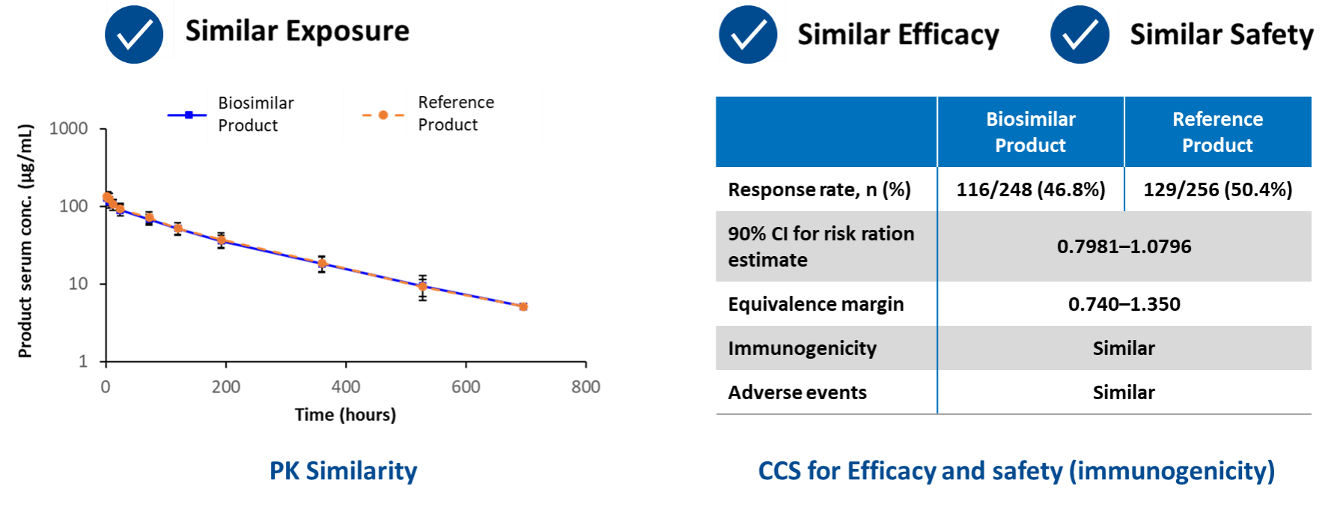
Clinical Studies to Demonstrate Similar Exposure, Efficacy, and Safety
Example for PK + CCS approach:

Slide 13
Comparative Analytical Assessment

Slide 14
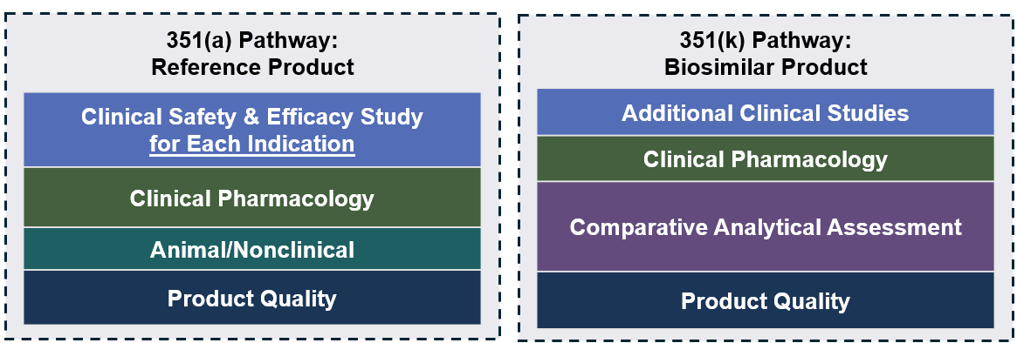
Comparative Analytical Assessment: The Foundation of the 351(k) Pathway
The comparative analytical assessment includes a rigorous and comprehensive comparison of quality attributes from multiple lots of the reference product and the proposed biosimilar product.
Comparative analytical studies include:
Physicochemical (structural) assays
Biological (functional) assays
These studies generate data about selected quality attributes that help provide information and assurance about the identity, quality, safety, purity, and potency of the proposed biosimilar as compared to the reference product.
The comparative analytical assessment is the foundation of FDA’s assessment of biosimilarity. Manufacturers also submit pharmacologic, immunologic, and additional clinical data as needed to demonstrate that a proposed product meets the standard for biosimilarity.

Slide 15
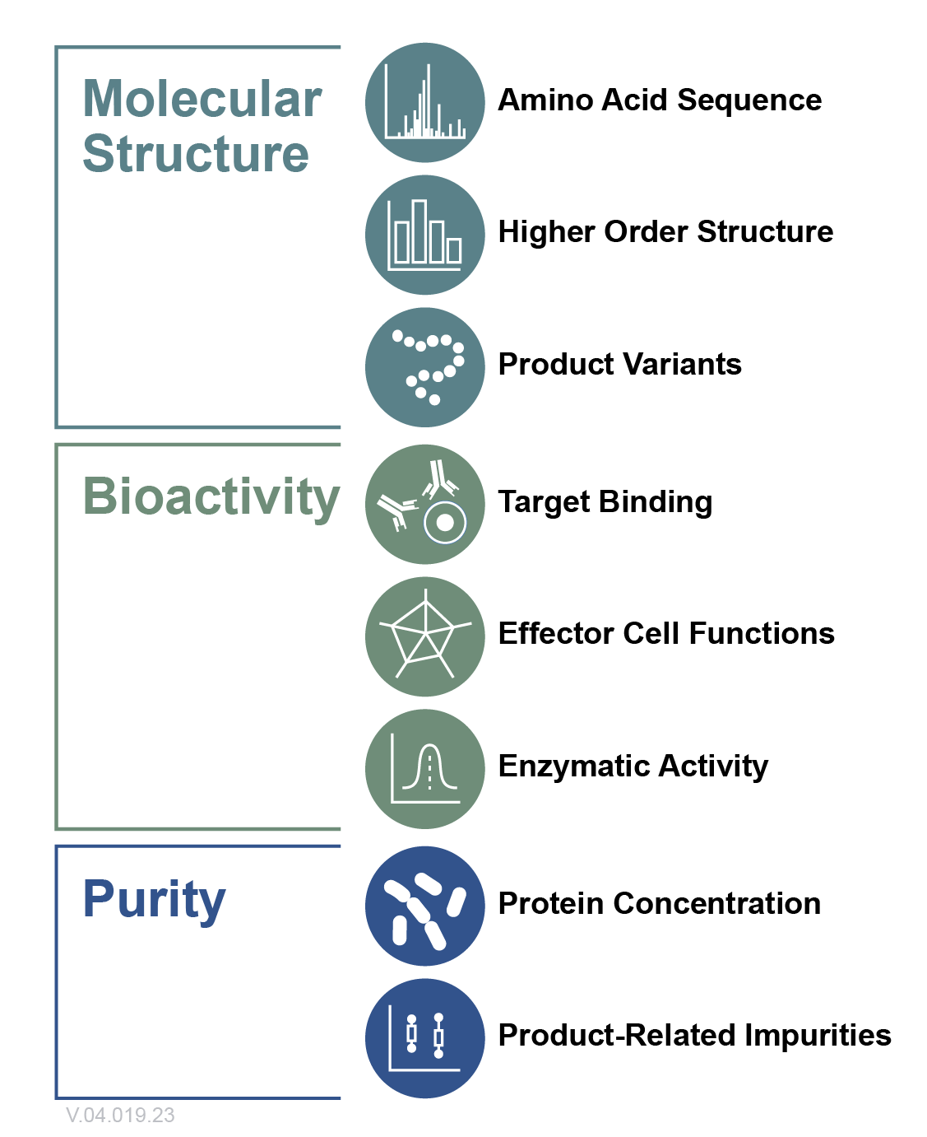
Identification and Measurement of Product Quality Attributes
The relative importance of quality attributes in assessment of analytical similarity depends on impact on clinical performance.
Sponsors identify quality attributes based on extensive knowledge of the biological product, publicly available information (e.g., published research), and information available about the reference product against which the proposed biosimilar product will be compared (e.g., quality reviews that list the critical quality attributes).*
Molecular structure, bioactivity, and purity are categories of quality attributes measured for in the comparative analytical assessment.
A manufacturer also evaluates additional attributes that demonstrate their proposed biosimilar product meets all of FDA’s rigorous quality standards for sterility, purity, and stability.
*The Drugs@FDA database includes information about most drugs, including biological products, approved for human use in the U.S., including FDA staff reviews that evaluate data and information on the safety and effectiveness of the approved product.

Slide 16
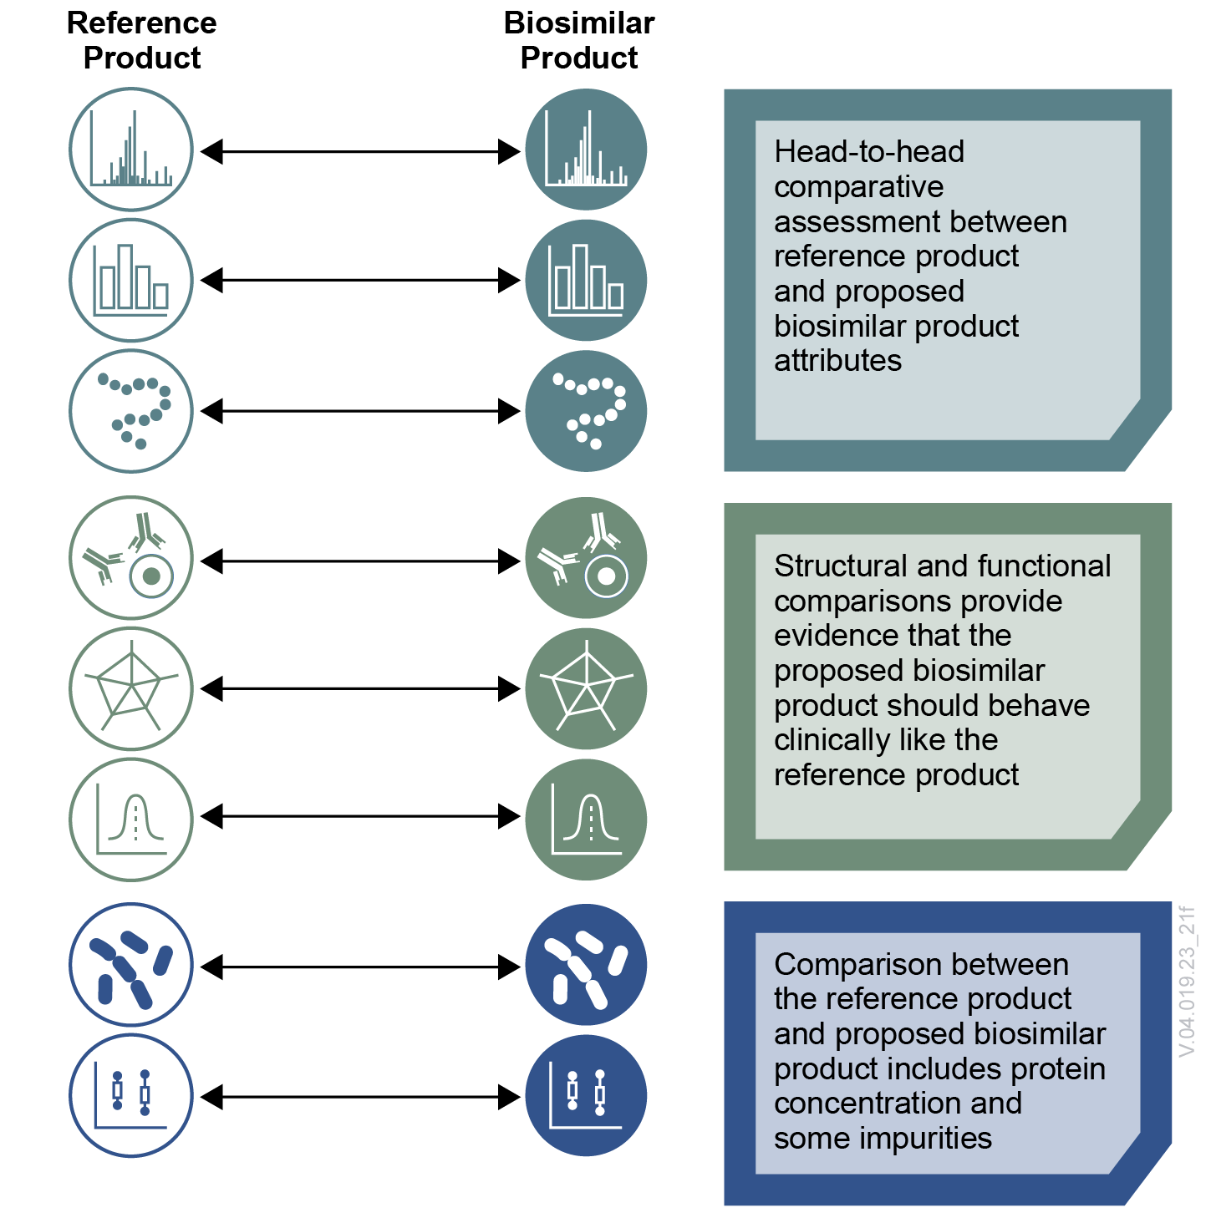
Characterizing Quality Attributes of the Reference and Biosimilar Product
The comparative analytical assessment includes a head-to-head comparison of the proposed biosimilar product and the reference product spanning multiple lots of each product.
Sufficiently sensitive analytical techniques can discriminate qualitative or quantitative differences in quality attributes.
The use of orthogonal quantitative methods is a best practice to identify differences in quality attributes.
Quality attributes are properties or characteristics that, when controlled within a defined limit, range, or distribution, ensure the desired product quality

Slide 17
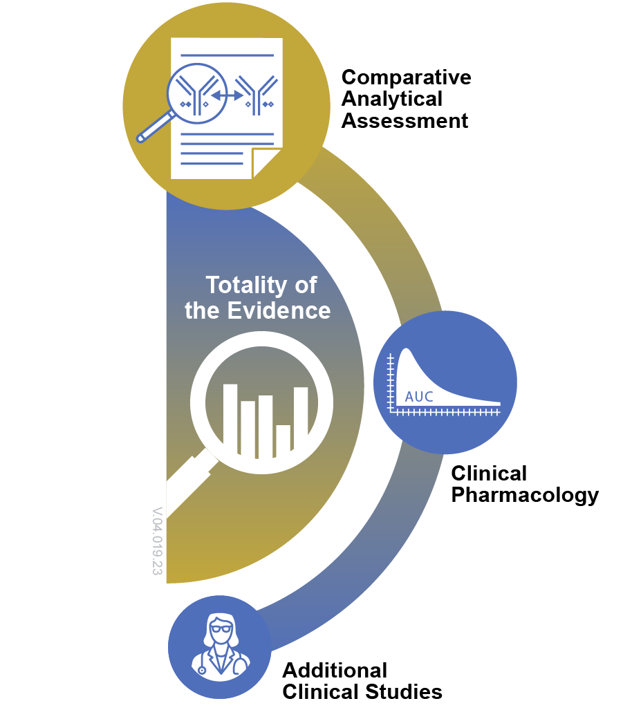
Evaluation of Biosimilarity Using a Totality-of-the-Evidence Approach
FDA evaluates proposed biosimilar products using the totality-of-the-evidence approach.
Biosimilar products must be highly similar in structure and function to an FDA-approved reference product, notwithstanding minor differences in clinically inactive components.
They also must have no clinically meaningful differences with respect to safety, purity, and potency from the FDA-approved reference product.
Using the totality-of-the-evidence approach, FDA considers all of the evidence provided by the applicant to make a regulatory decision about the proposed product’s biosimilarity to the reference product.
Quantitative and qualitative comparisons between analytical data from the proposed biosimilar product and the reference product are the foundation for a demonstration of biosimilarity.

Slide 18
Comparative Analytical Assessment and Product Quality

Slide 19
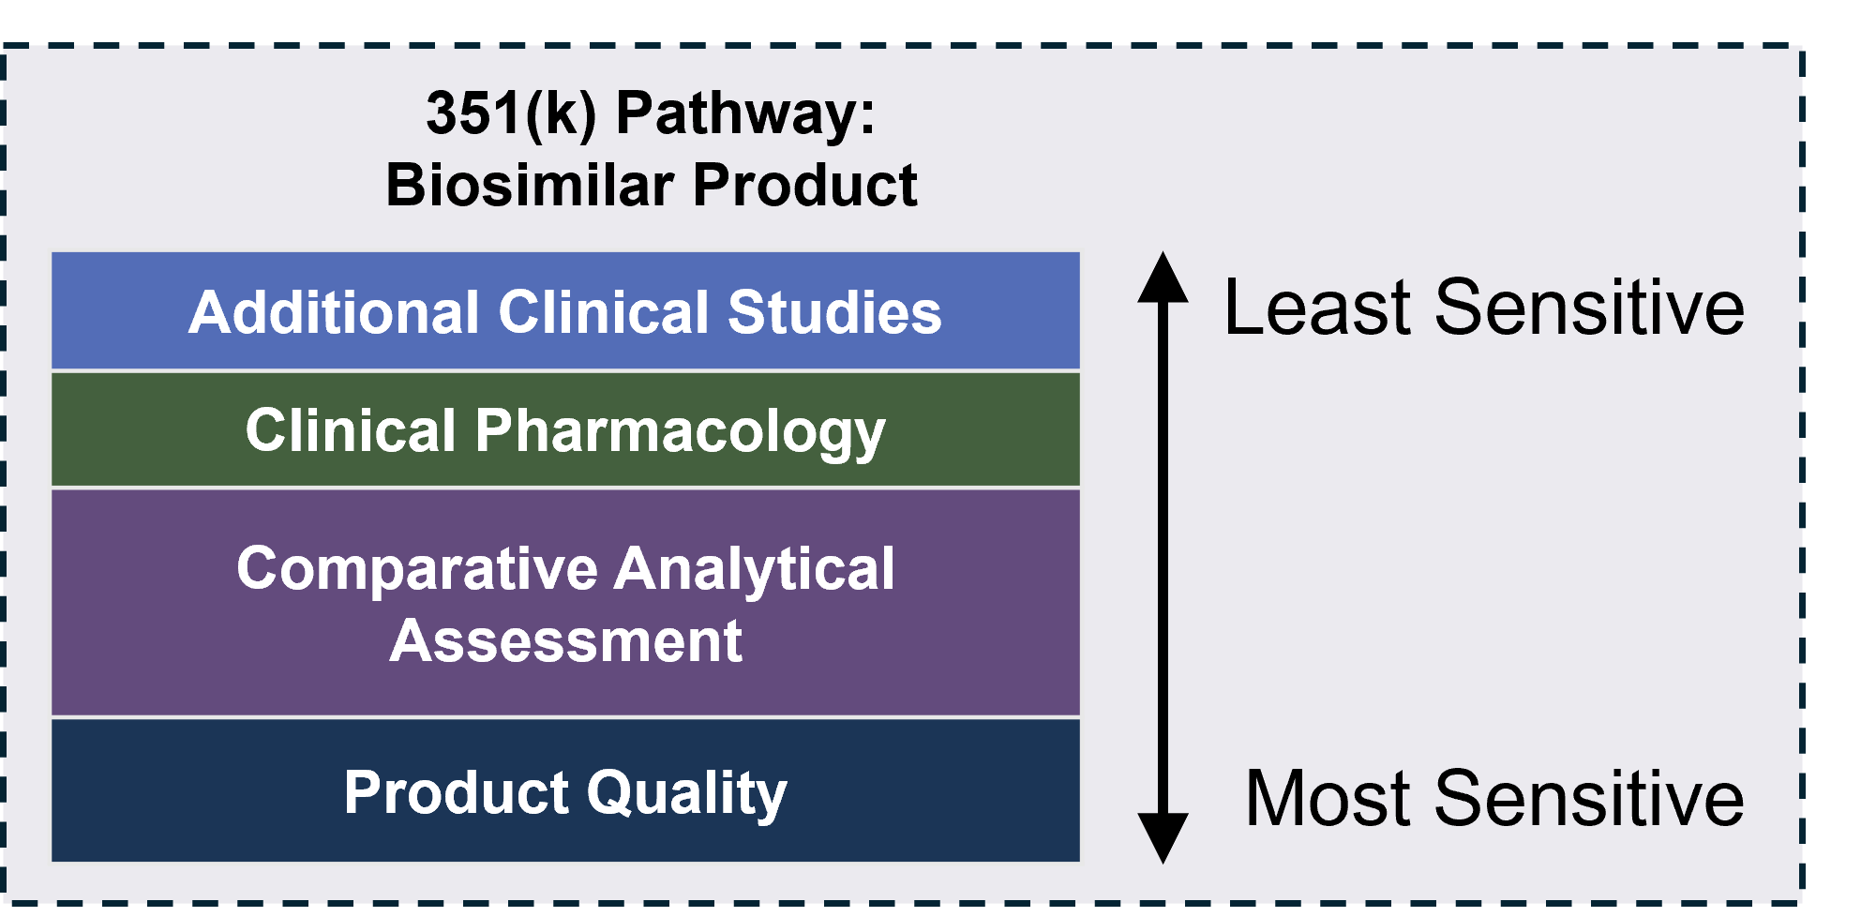
Analytical Studies are the Foundation of the 351(k) Pathway
If a biosimilar is highly similar in structure and function to the reference product, it should be as safe and effective as the reference product.
Under the 351(k) abbreviated approval pathway, a biosimilar product can be approved based on a scientific demonstration that it is highly similar to an approved reference product that has been determined to be safe and effective for each of its labeled indications.
Analytical studies are generally much more sensitive than clinical studies in detecting differences between products, should differences exist.

Slide 20
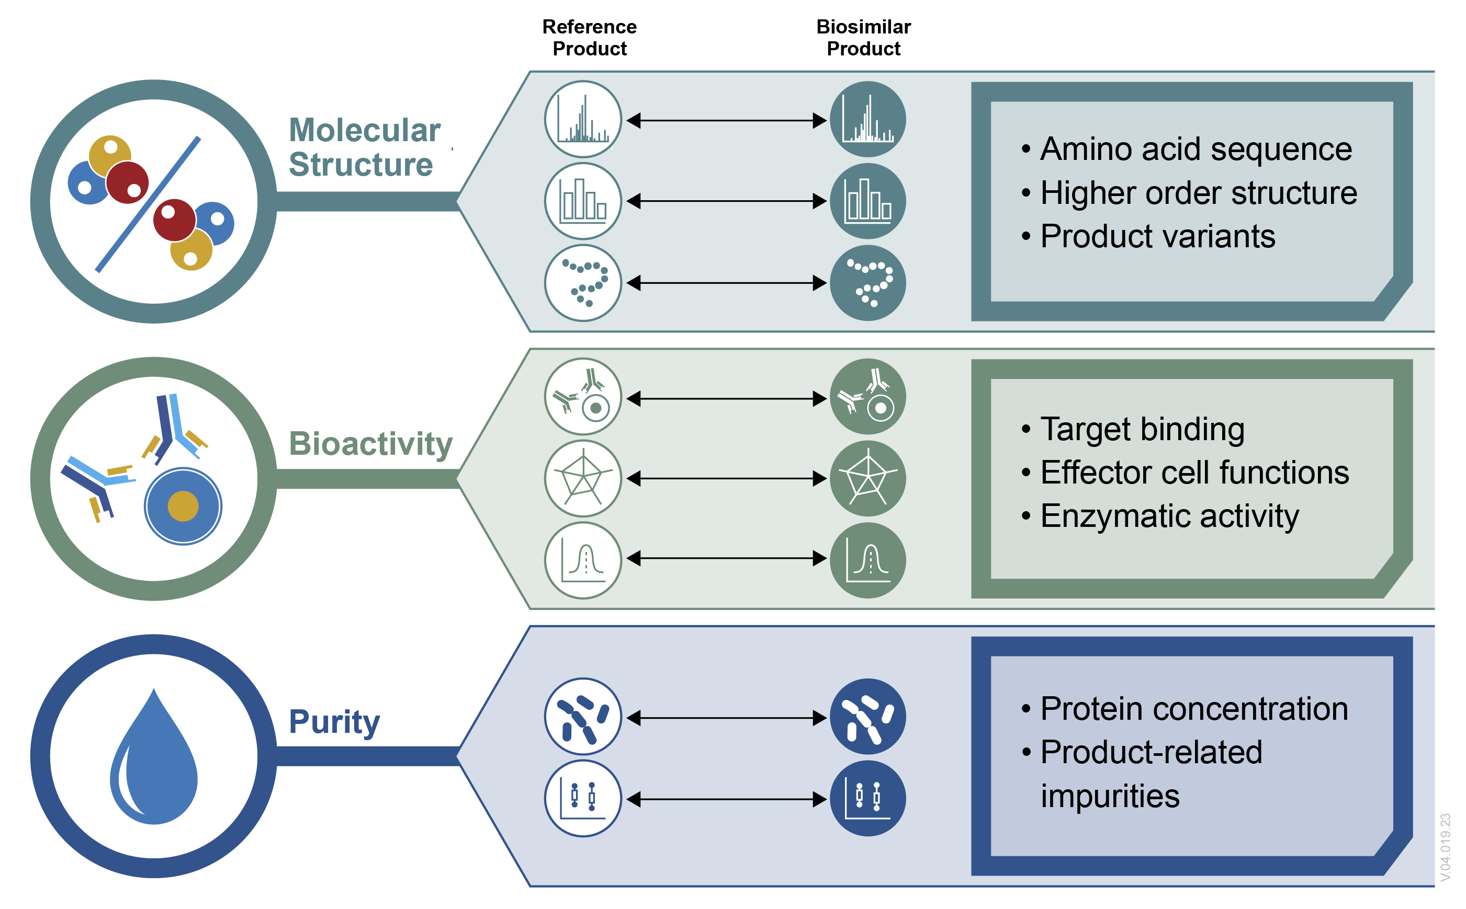
Identification of Product Quality Attributes
Some molecular properties carry more weight in the comparative analytical assessment due to the known or uncertain impact of their performance on product quality and clinical performance.
Based on the nature of the protein and other information, particular focus is placed on a critical selection of molecular properties (also known as quality attributes) that are important to demonstrate biosimilarity.
Attributes are measured through physicochemical and functional studies and compared in a head-to-head comparative assessment.
FDA expects that biosimilar product quality attributes should be within an appropriate limit, range, or distribution compared to the reference product to ensure the desired product quality.
* Some attributes may be highly critical (e.g., protein structure) but not amenable to quantitative analysis. Recommendations for design and evaluation of comparative analytical studies can be found in FDA's published guidance.

Slide 21
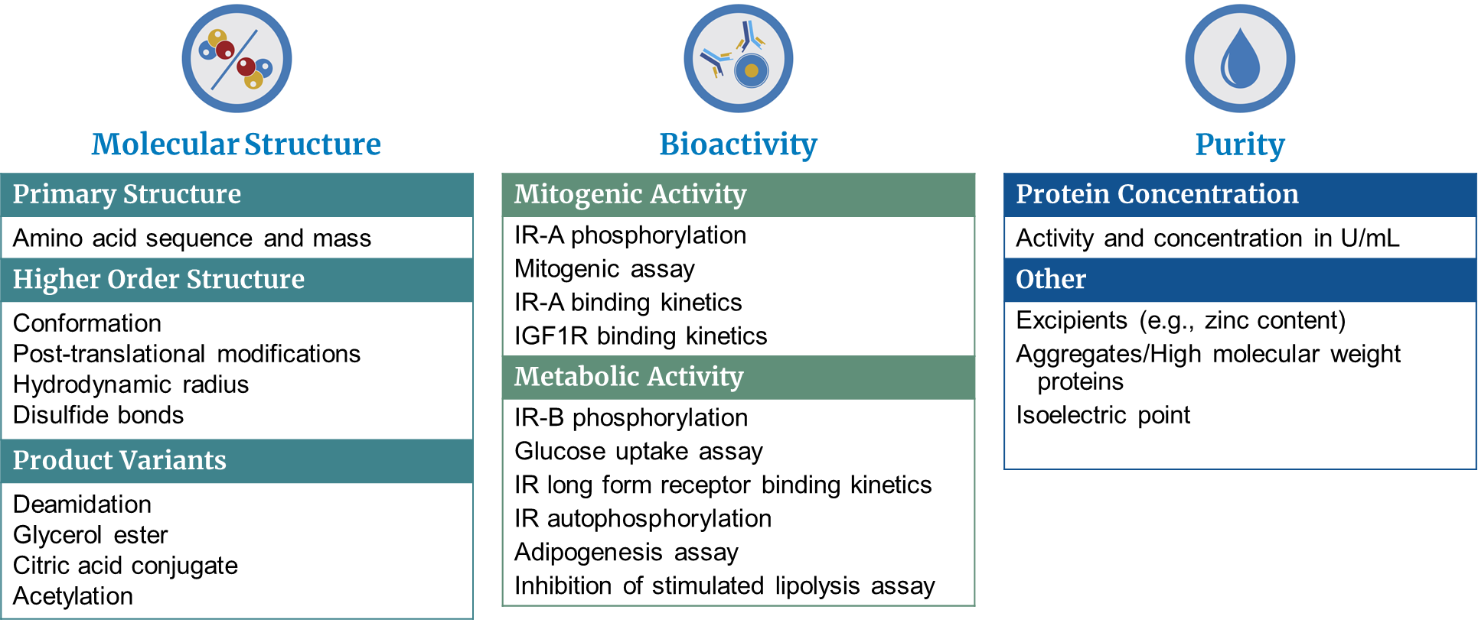
Critical Quality Attributes Example:
Insulin Products
21

Slide 22
Illustrative Critical Quality Attribute: Post-Translational Modifications
Most protein products undergo post-translational modifications that can alter the structure, function, and interactions of the protein. Some of these modifications may impact receptor binding or other bioactivity related to a therapeutic protein’s mechanism of action. Post-translation modifications can occur during the manufacture of biosimilars and reference products.
Post-translational modifications occur after the translation of mRNA into a protein. These modifications include:
Addition of one or more chemical groups (e.g., glycans, acetyl, phosphate, or methyl group) to one or more amino acids in the protein
Removal or conversion of one or more chemical groups linked to amino acids in the protein
Breakdown of the protein via proteolytic cleavage of the covalent bonds between amino acids

Slide 23
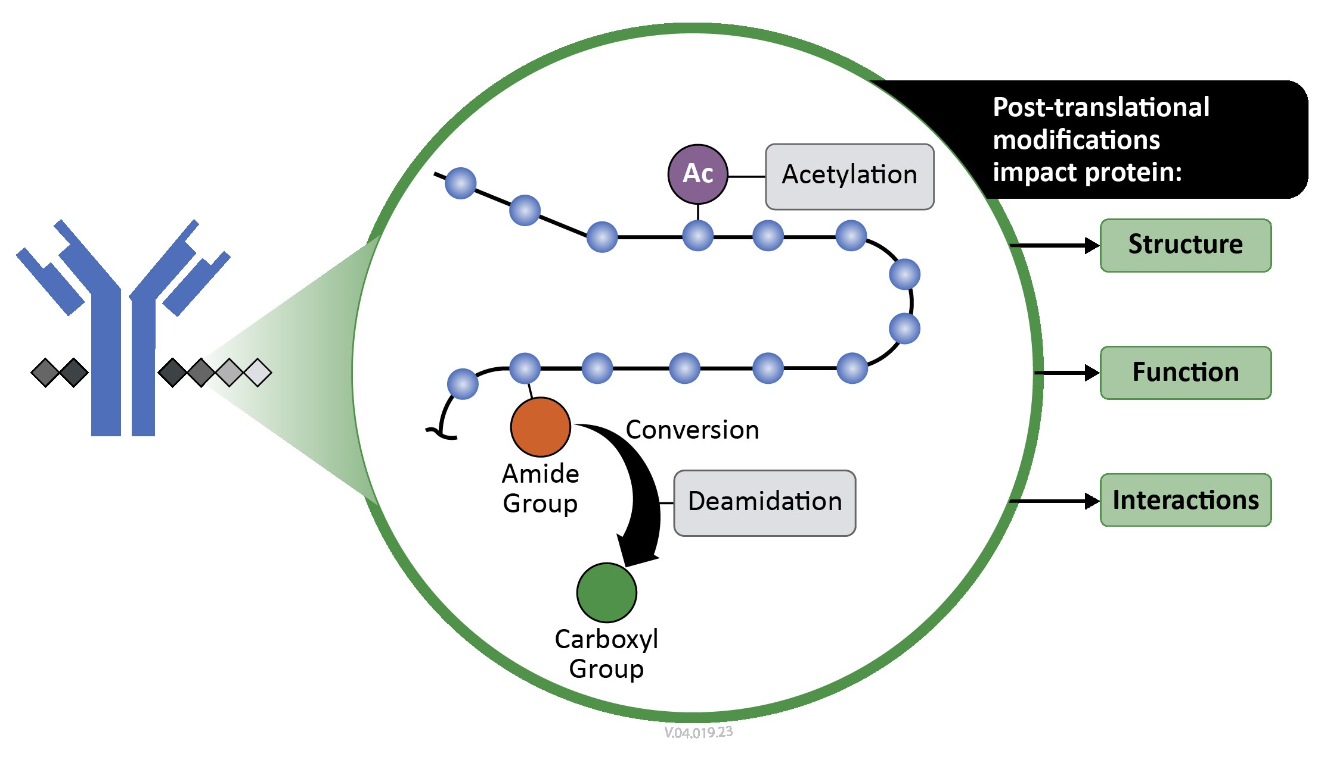
Illustrative Quality Attribute: Post-Translational Modifications
Differences in types and amounts of modified protein variants may impact product safety or effectiveness; therefore, the CAA includes identifying and comparing variants between a biosimilar product and reference product.
Post-translational modifications can occur at any part of the protein’s lifecycle and are impacted by multiple factors (e.g., cell culture methods, manufacturing processes, storage conditions).
Variability or post-translational modifications are often expected but are carefully controlled for both a biosimilar and the reference product.
The desired biological product can be a mixture of anticipated post-translationally modified protein variants.
Manufacturers identify and determine the relative levels of modified protein variants across multiple lots of the biosimilar and reference products.
These modifications are just one source of the biological variability evaluated as part of a complete biosimilar application.

Slide 24
Commonly Encountered Post-Translational Modifications
Post-Translational Modification* | Description
Acetylation | Addition of an acetyl group (CH₃CO) to a protein. Specific examples include N-terminal acetylation, which occur on the free α-amino group (NH³⁺) at the N-terminal end of a polypeptide.
Phosphorylation | Addition of a phosphoryl group (PO₃) to a protein. Phosphorylation can occur at the side chains of three amino acids: serine, threonine and tyrosine.
Methylation | Addition of a methyl group (CH₃)to a protein. The amino acids most typically methylated include lysine and arginine.
Glycosylation | Addition of a glycan (i.e., sugar) molecule to a protein. Glycans can differ in glycan composition and branching structure. The amino acids frequently glycosylated include asparagine, serine, and threonine.
Proteolytic Cleavage | Breakage of a peptide bond(s) between amino acids in a protein. Proteolytic cleavage is catalyzed by enzymes called proteases.
Deamidation | Removal or conversion of an amide group linked to amino acid(s) in a protein. Deamidation can occur at the amino acids asparagine or glutamine.
Methods for Measurement*
Mass Spectrometry-Based Techniques Tandem Mass Spectrometry (MS/MS) Ion-Exchange High-Performance Liquid Chromatography (IE-HPLC) Liquid Chromatography – Mass Spectrometry Peptide Mapping (LC/MS) Antibody-Based Techniques Protein Microarrays Immunohistochemistry Western Blot Enzyme-Linked Immunosorbent Assay (ELISA) Proximity Ligation Assay
* Note: The definitions and measurement methods provided are not exhaustive.

Slide 25
Clinically Inactive Components in Demonstration of Biosimilarity
Comparison of a proposed biosimilar product to its reference product includes assessment of excipients and impurities that may impact product stability or clinical performance.
Product-related impurities are compared as part of the comparative analytical assessment and the data should support that the proposed biosimilar product is highly similar to the reference product notwithstanding minor differences in clinically inactive components.
Process-related impurities (e.g., cell culture components, reagents, residual solvents) and excipients are not expected to match those observed in the reference product. Impurities are evaluated to establish product quality but are not included in the comparative analytical assessment. If there are differences in types and amounts of excipients between the proposed biosimilar and reference product, the comparative analytical assessment can assess their impact on product quality attributes relevant for clinical performance.

Slide 26
Insulins/Interchangeability

Slide 27
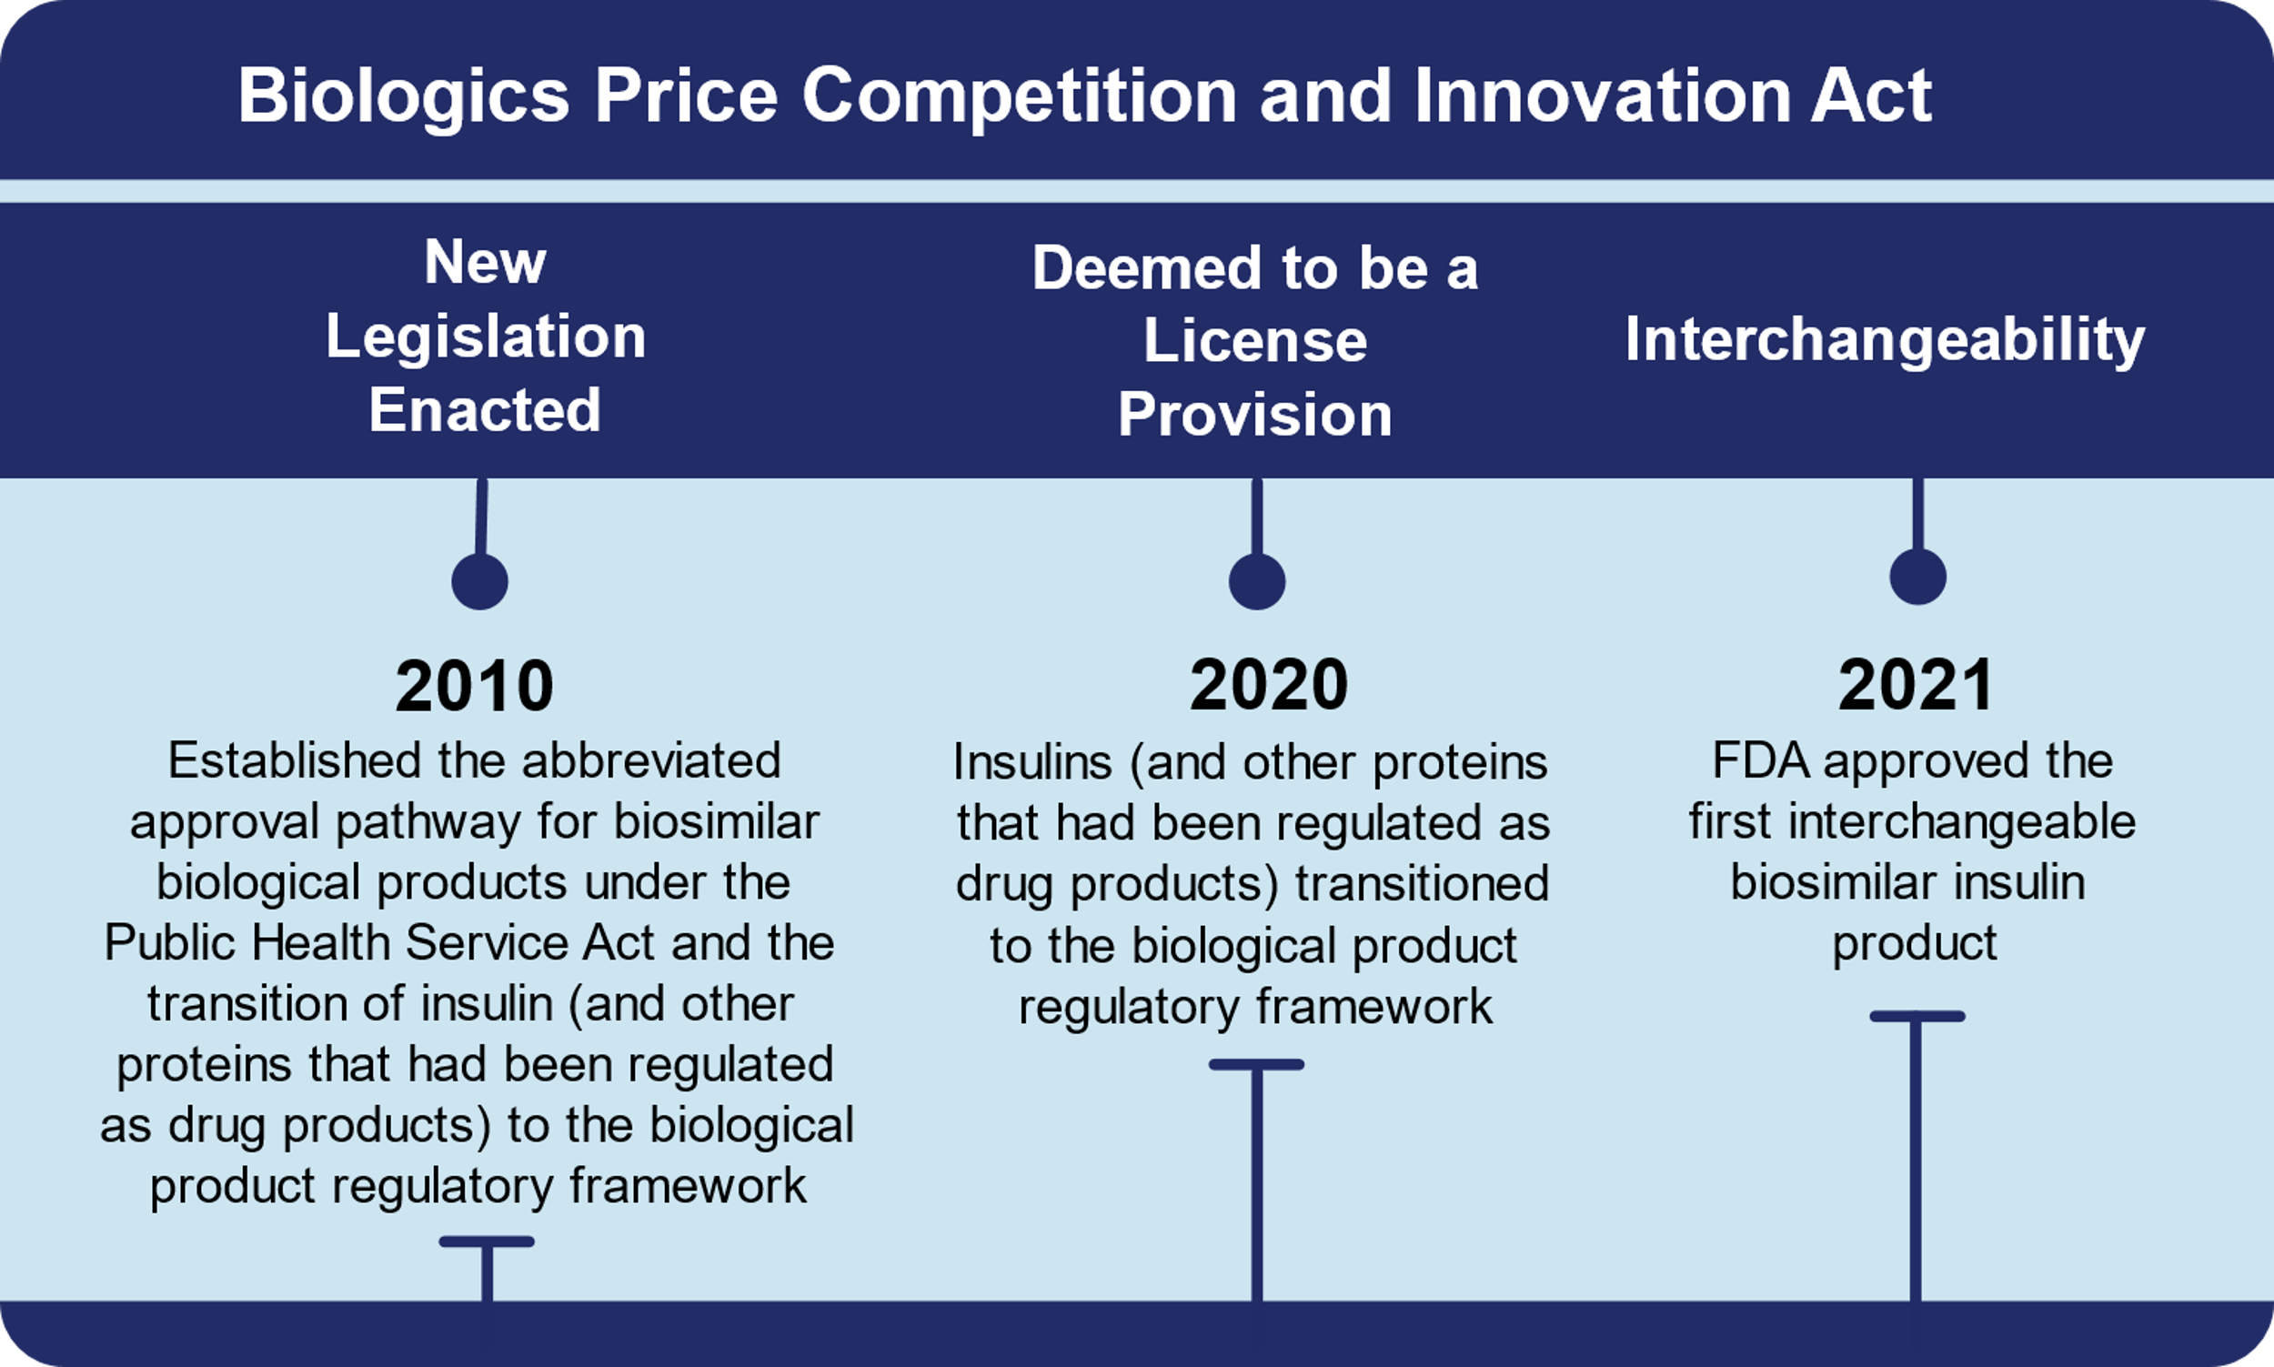
Biosimilar and Interchangeable Products in Primary Care and Community Practice: Insulins
Insulin is a widely prescribed biological product used by patients on a daily basis. Multiple biosimilar and interchangeable biosimilar product options are on the market.
The introduction of the 351(k) pathway, established by the Biologics Price Competition and Innovation Act (BPCIA) in 2010, created an abbreviated pathway for approval of biosimilar and interchangeable biosimilar products.
In March 2020, insulins were transitioned to the biological product regulatory framework. Prior to that, they were subject to the drug regulatory framework for historical reasons. Regulating insulins as biological products allowed for the approval of biosimilar and interchangeable biosimilar insulin products under the 351(k) pathway.
FDA approved the first interchangeable biosimilar insulin product in 2021. For the most up-to-date information about biological products, including available biosimilar and interchangeable biosimilar insulin options, visit the FDA’s Purple Book Database of Licensed Biological Products.
Biosimilar insulin products increase the presence of biosimilars in primary care and community practice settings and provide patients with additional safe, high-quality, and potentially less costly treatment options for diabetes.
FDA has information about biosimilar products for providers as well as information and messaging for patients with diabetes using these products.

Slide 28
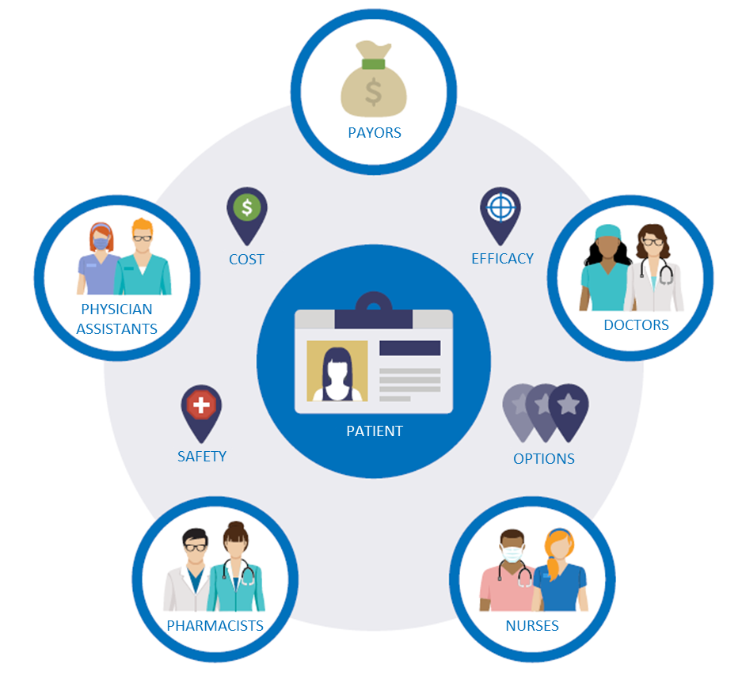
Adoption of Biosimilars
Patients seek information primarily from their health care providers (e.g., doctors, nurses, physician assistants, pharmacists) as trusted sources on the safety and effectiveness of potential treatment options.
Understanding patients’ needs for information related to biosimilars can support health care providers as they have conversations about biosimilars in the shared decision-making process.
As the number of available biosimilar and interchangeable products grow, providers will increasingly encounter patients taking a biosimilar product in primary care and community health settings (e.g., patients taking insulin).

Slide 29
Biosimilar Naming

Slide 30
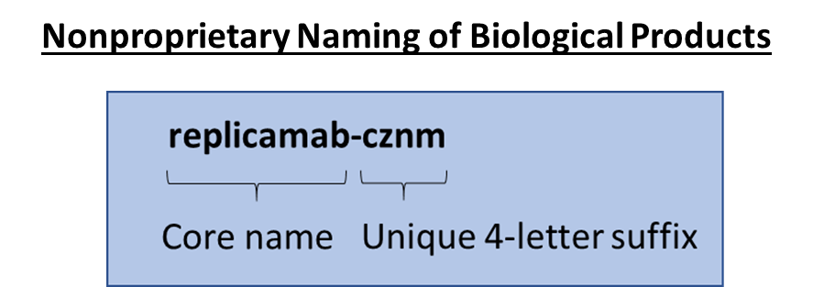
Biologics Naming Conventions
Many biologics*, including reference, biosimilar, and interchangeable biosimilar products, are subject to FDA’s naming policy.
The naming convention is a combination of a nonproprietary core name and a unique, product-identifying 4-letter suffix to help distinguish products.
FDA adopted the naming convention to help with pharmacovigilance and safe use for all biologics and to help patients and providers know which biologic medicine is being prescribed and dispensed.
Health care professionals should include the 4-letter suffix when ordering, prescribing, dispensing, and in recordkeeping and pharmacovigilance practices, including reporting adverse events to MedWatch, the FDA Safety Information and Adverse Event Reporting Program.
The biosimilar or interchangeable biosimilar will share the same core name as its reference product.
*Note: Some reference products approved prior to implementation of the naming convention may not have a suffix.

Slide 31
Practical Considerations for Using Biosimilars and Interchangeable Biosimilars

Slide 32
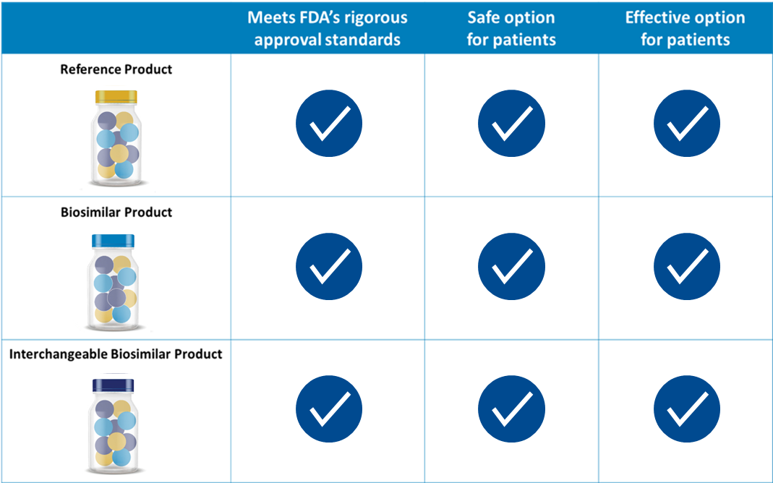
Biosimilars Are as Safe and Effective as the Reference Product
Patients and health care providers can be as confident in the safety and effectiveness of the biosimilar and interchangeable biosimilar as they can for the reference product.
Biosimilar and interchangeable biosimilar products can be used in patients who have previously been treated with the reference product (i.e., treatment-experienced), and in patients who have not previously been treated with the reference product (i.e., treatment-naïve).

Slide 33
Immune Response to Biologics
Biologics, including both reference products and biosimilars, have a risk of immunogenic response.
Immunogenicity refers to the potential for the body to elicit an immune reaction in response to a biologic, which, in rare cases, may result in decreased efficacy or increased safety risk of the product.
Biosimilars are expected to generally have the same type and amount of immunogenic response as the reference product.
If a patient does not respond to the biologic or develops anti-drug antibodies, then the same can be expected with the biosimilar.

Slide 34
Biosimilar and Interchangeable Biosimilar Labeling
Although biosimilars have the same strength and dosage, are administered the same way as the reference product, and have the same potential treatment effects and potential side effects, a biosimilar is not required to have the same labeling as its reference product.
Biosimilar and interchangeable biosimilar labeling:
Provides approved prescribing information that summarizes the scientific information health care practitioners need for safe and effective use of the product.
Includes relevant data and information from the reference product labeling, including clinical data that supported FDA’s finding of safety and effectiveness for the reference product.
Contains “Highlights of Prescribing Information” with a “Biosimilarity Statement” describing the product’s relationship to its reference product.
Health care professionals are advised to review the labeling (i.e., prescribing information) of the biosimilar to determine the conditions of use (e.g., indications, dosing regimens) and routes of administration for which the biosimilar is approved.
See FDA’s Purple Book Database and Drugs@FDA for more details.

Slide 35
Resources

Slide 36
The Purple Book
The Purple Book: Database of Licensed Biological Products is a user-friendly online database with information on all FDA-approved biologics. It provides patients, payors, clinicians, and others with an accessible, easy-to-use online search engine with information about FDA-approved biologics, including whether a specific biologic is a reference product, biosimilar, or interchangeable biosimilar.
Features of the Purple Book
Simple and advanced search options
Auto-suggest search function
Additional search filters
Data download options
Links to product labels (Drugs@FDA)
Ability to show/hide sortable columns of information
Ability to print or export search results
Searchable glossary of terms
purplebooksearch.fda.gov

Slide 37
Health Care Provider Materials
FDA has developed a growing library of resources (e.g., videos, fact sheets, infographics, toolkits) that offers providers information they can use to increase understanding of biosimilars and interchangeable biosimilars.

Slide 38
Addressing Patient Questions
Patients may have questions for their health care providers about biosimilars on topics such as safety, effectiveness, quality, and cost. When addressing patient questions, in addition to their experiences from professional practice, providers can also direct patients to resources from FDA or patient advocacy/ disease-specific associations, as appropriate.
FDA’s Patient Materials:
Use patient-friendly language and imagery.
Address topics, concerns, and misconceptions shown to be most important to patients.
Were tested with patient advocacy organizations and with patients treated with a biologic.
Include frequently asked questions, infographics, and more.
For more information on patient education, please visit: https://www.fda.gov/drugs/biosimilars/patient-materials

Slide 39
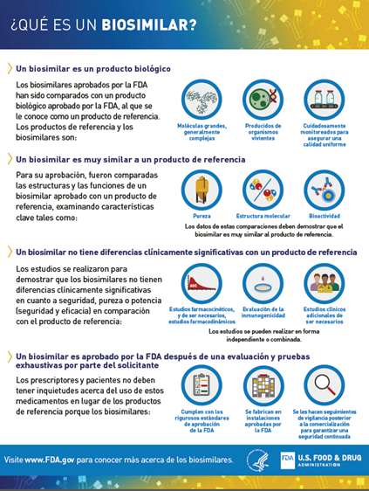
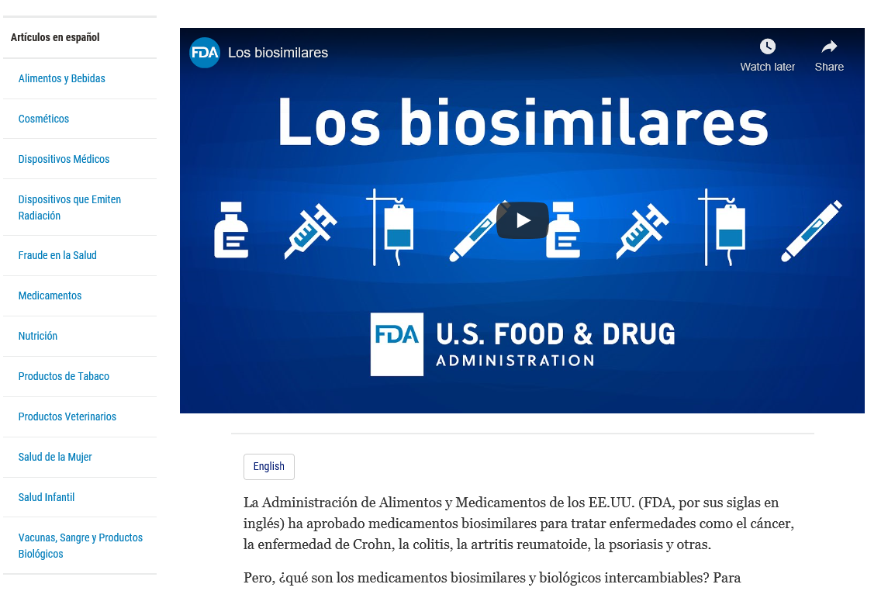
FDA Biosimilar Materials in Spanish
https://www.fda.gov/drugs/biosimilars/conceptos-basicos-de-los-biosimilares-para-los-pacientes

Slide 40
Resources
FDA Pages
Biosimilar materials
Provider materials
Patient materials
Purple Book
Drugs@FDA (Drug Information)
Search page for FDA guidances
Advisory committee materials for biosimilars
Biosimilar approval process information
Additional Resources for Health Care Students
Resource Guide for Teaching Faculty
Slide Decks (Levels 1 and 2):
Foundational Concepts
Regulatory and Scientific Concepts
Case study (Levels 1 and 2):
What Is a Biosimilar?
Biosimilars in Patient Care
Interchangeable Biosimilars
Biosimilar and Interchangeable Biosimilar Insulin Products
Comparative Analytical Assessment – Data Supporting Biosimilarity
Info sheets (Levels 1 and 2):
Biological Products, Biosimilar Products, and Interchangeable Biosimilars Products
Generics and Biosimilars
Manufacturing and Variation
Biosimilar Regulatory Approval Pathway
Variation in Biological Products
Comparative Clinical Studies
Prescribing Biosimilar Products and Interchangeable Biosimilar Products
Navigating the Purple Book Database of Licensed Biological Products
Biosimilar and Interchangeable Biosimilar Insulin Products
Comparative Analytical Assessment and Product Quality
Biosimilar Product Quality Attributes
Labeling for Biosimilar and Interchangeable Biosimilar Products
Explanatory Videos (Levels 1 and 2):
Biosimilars: Manufacturing and Inherent Variation
Biosimilars: Approval Process
Biosimilars: Critical Quality Attributes
Biosimilars: Interchangeability
Biosimilars: The Purple Book
A Walk-Through of FDA’s Purple Book: Database of Biological Products
Biosimilars: Totality of the Evidence in Biosimilar Development
Biosimilars: Comparative Analytical Assessment
Discussion Questions (Levels 1 and 2)
Foundational Concepts
Regulatory and Scientific Concepts
Exercises (Levels 1 and 2) Provided in the Resource Guide for Teaching Faculty
Resources

Slide 41
Key Takeaways

Slide 42
Key Takeaways
Variation in biologics and safety of biosimilars | Naming | Labeling | Prescribing and substitution | Resources
Reference products and biosimilar are approved through different regulatory pathways. All biologics (both reference products and biosimilars) contain slight, natural variation as they are typically manufactured from living sources. Assessments are performed to compare the biosimilar to the reference product to ensure that any inherent variability in the final product does not result in any clinically meaningful differences in terms of safety and effectiveness. | Many biologics, including most recently approved reference products, and all biosimilars, and interchangeable biosimilars, are subject to FDA’s nonproprietary naming policy for biologics. The naming convention for biologics is a nonproprietary name consisting of a core name and a unique, product-identifying 4-letter suffix. The naming convention helps patients and providers know which biologic is being prescribed and dispensed. | Health care professionals are advised to review the labeling (i.e., prescribing information) of the biosimilar to determine the conditions of use (e.g., indications, dosing regimens) and routes of administration for which the biosimilar is approved. | Health care professionals can prescribe biosimilars and interchangeable biosimilars just as they would prescribe other medications. FDA-approved interchangeable biosimilars may be substituted for the reference product without the intervention of the prescribing health care provider, subject to state laws. Laws differ by state on biologic substitution. | Purple Book is an online database on FDA-approved biologics. It includes simple and advanced search functions. Listings include links to product labels and other information via Drugs@FDA. FDA has patient and provider resources on its website: Provider resources Patient resources (English) Patient resources (Spanish)

Slide 43
Knowledge Assessment

Slide 44
Multiple Choice Questions – 1 of 6
Section: Biological Product Complexity
Q1: Minor inherent variation occurs during manufacturing of biological products. Which statement(s) is true about inherent variation?
Minor inherent variation occurs during the manufacturing of both reference products and biosimilar products as both are typically manufactured from living cells.
Each lot of the reference product and biosimilar product can show slight difference in molecular structure due to inherent variation.
As part of the approval process, FDA assesses manufacturers’ strategies to control for the pattern and degree of variations between different lots of the biological product to ensure that all biological products are safe, effective, and high quality.
*All of the above.
None of the above.

Slide 45
Multiple Choice Questions – 2 of 6
Section: Biological Product Complexity
Q2: What data must biosimilar manufacturers demonstrate as part of the approval process?
Biosimilar manufacturers do not have to generate the same profile of data as for reference products. Instead, data are generated and evaluated from a foundation of detailed analytical characterization, and a structural and functional comparison of the products including, if needed, animal and toxicity studies.
Biosimilar manufacturers must provide comprehensive comparative analytical data to demonstrate that the biosimilar is highly similar to the reference product. This also includes studies to understand the heterogeneity of biological products and the strategies to control for ranges of variability of different forms by standardizing the manufacturing process.
Biosimilar manufacturers must demonstrate that no clinically meaningful differences exist between the biosimilar product and reference product by providing comparative clinical pharmacology data (i.e., pharmacokinetics, and where applicable, pharmacodynamics), and if needed, additional clinical studies.
B and C.
* A, B, and C.

Slide 46
Multiple Choice Questions – 3 of 6
Section: Approval Pathways
Q3. What types of data are needed for approval of a biosimilar?
Comprehensive analytical studies, which form the foundation to demonstrate biosimilarity to an FDA-approved reference product. This includes data on the structure, purity, and bioactivity of the molecule.
Comparative animal studies to assess toxicity of the biosimilar product as compared to the reference product, if needed.
Comparative clinical study (or studies), if needed, to demonstrate safety, purity, and potency in one or more appropriate conditions of use for which licensure is sought for the biosimilar product. This often includes a comparison of pharmacokinetics (PK), pharmacodynamics (PD) if applicable, and may include comparison of clinical effect, safety, and immunogenicity.
Clinical trials to establish efficacy and safety in each indication for which licensure is sought.
* A and C.

Slide 47
Multiple Choice Questions – 4 of 6
Section: Approval Pathways
Q4: A meaningful analytical assessment should include comprehensive physicochemical and functional studies. Which of these statements is false?
A physicochemical assessment should consider all relevant physical characteristics of the therapeutic protein. This assessment should detect differences in quality attributes between the proposed biosimilar product and the reference product. Examples may include characterization of molecular weight, complexity, degree of heterogeneity, impurity profiles, and degradation profiles of the protein.
Functional studies complement the physicochemical analyses and provide a quantitative measure of the function of the protein (e.g., biological assays, binding assays, enzyme kinetics, assessing the occurrence of neutralizing antibodies).
* Totality of evidence is not important when assessing a 351(k) application. FDA does not consider the totality of the physicochemical and functional comparative evidence between the biosimilar product and the reference product, or clinical data comparing the biosimilar product and reference product.
The analytical assessment serves as the foundation for demonstrating biosimilarity to the reference product in the 351(k) biosimilar regulatory approval pathway. Additional clinical studies are likely also needed to demonstrate biosimilarity.

Slide 48
Multiple Choice Questions – 5 of 6
Section: Biosimilar Labeling
Q5: Approved prescribing information summarizes the scientific information health care practitioners need for safe and effective use of biosimilar products and interchangeable biosimilar products. Which of these statements is true?
A biosimilar product can be approved by the FDA for some or all of the same conditions of use, strengths, dosage forms, and routes of administration as the FDA-approved reference product.
The highlights of Prescribing Information in a biosimilar product or interchangeable biosimilar product label describes its relationship to the reference product.
Biosimilar products are expected to have same potential benefits and risks (side effects) as the reference product.
Specific information on the biosimilar product and reference product can be found in FDA’s Purple Book.
* All of the above.

Slide 49
Multiple Choice Questions – 6 of 6
Section: Prescribing Biosimilars
Q6: Which statement is false about biosimilar and interchangeable biosimilar products?
Approved biosimilar products can be used in patients who are treatment-experienced (i.e., already used the reference product or biosimilar product) and treatment-naïve (i.e., never used the reference product or biosimilar product).
Biosimilar products are expected to have the same rate of immunogenic response as the reference product. If a patient doesn’t respond to the reference product or develops anti-drug antibodies, the same can be expected with the biosimilar.
FDA may require additional studies (switching studies) to show that a biosimilar is interchangeable with its reference product.
An interchangeable biosimilar product may be substituted without intervention of the healthcare provider subject to state laws.
* Interchangeable biosimilar products are safer and more effective than a regular biosimilar product.

