Slide 1
Pediatric Advisory Committee Meeting
Pediatric Advisory Committee Meeting
September 18, 2024
10:00 a.m. – 4:00 p.m. EST
Meeting notice and materials are available on the PAC website
2024 Meeting Materials, Pediatric Advisory Committee | FDA
Please direct all technical inquiries to the email listed below
Virtual-WOCC-Support@fda.hhs.gov

Slide 2
Information for Media/Press and Public
Please contact the Press Officer (listed below) from the FDA Office of Media Affairs to document your attendance, ask questions, or make interview requests for any FDA speakers:
April Grant
Email: April.grant@fda.hhs.gov
Phone number: 202-657-8179
For Open Public Hearing speakers, industry and the press, please sign in by sending an email to PAC@fda.hhs.gov
Please direct all technical inquiries to the email listed below
Virtual-WOCC-Support@fda.hhs.gov

Slide 3
Closed Captioning
Closed captioning can be accessed by clicking on the icon pictured here within the Zoom platform:

Slide 4
Pediatric Advisory Committee Meeting September 18, 2024
Call to Order
Gwenyth Fischer, MD
Chairperson, PAC

Slide 5
Pediatric Advisory Committee Meeting Roster
Douglas Diekema, MD, MPH
Gwenyth Fischer, MD
PAC Chairperson
David Callahan, MD
Angela Czaja, MD, PhD
Jennifer Goldman, MD, MS
Pediatric Health Organization Representative
Charleta Guillory, MD, MPH
Richard Holubkov, PhD
Bridgette Jones, MD, MS
Steven Krug, MD
Gianna McMillan, D. Be
Patient/Family Representative
Robert Nelson, MD, PhD
Industry Representative
Roberto Ortiz-Aguayo, MD
Randi Oster, MBA
Consumer Representative
Michael White, MD, PhD

Slide 6
Pediatric Advisory Committee Meeting September 18, 2024
Introduction of FDA Representatives
Shivana Srivastava, RN, MS, DCPM, PMP
Designated Federal Officer, PAC

Slide 7
Pediatric Advisory Committee Meeting September 18, 2024
Conflict of Interest Statement
Shivana Srivastava, RN, MS, DCPM, PMP
Designated Federal Officer, PAC

Slide 8
Pediatric Advisory Committee Meeting September 18, 2024
FDA Opening Remarks
Dionna Green, MD, FCP
Director, Office of Pediatric Therapeutics
Office of Clinical Policy and Programs
Office of the Commissioner, FDA

Slide 9
Purpose of the Meeting
The Pediatric Advisory Committee (PAC) is meeting to discuss pediatric-focused postmarket safety reviews as mandated by the Best Pharmaceuticals for Children Act (Pub. L. 107-109), the Pediatric Research Equity Act of 2003 (Pub. L. 108-155), and the Pediatric Medical Device Safety and Improvement Act of 2007 (Pub. L. 110-85, title III)

Slide 10
PREA Non-Compliance Letters
Center for Biologics Evaluation and Research (n=6)
https://www.fda.gov/about-fda/center-biologics-evaluation-and-research-cber/prea-non-compliance-letters
Center for Drug Evaluation and Research (n=159)
https://www.fda.gov/drugs/development-resources/non-compliance-letters-under-505bd1-federal-food-drug-and-cosmetic-act
The websites list the sponsor, product, a copy of the non-compliance letter, the sponsor’s response (if available), and the status of the PREA requirement (e.g., released, replaced, fulfilled)

Slide 11
PREA Non-Compliance Letters
Center for Biologics Evaluation and Research (n=6)
No new letters since the last Pediatric Advisory Committee Meeting
Center for Drug Evaluation and Research (n=159)
24 new letters since the last Pediatric Advisory Committee Meeting

Slide 12
Non-Compliance Letters (CDER)
Sponsor | Product | Date of Letter
Primus Pharmaceuticals Inc | Impoyz (clobetasol propionate) cream | 7/26/23
Primus Pharmaceuticals Inc | Impoyz (clobetasol propionate) cream | 2/21/24
Neos Therapeutics Brand, LLC | Cotempla XR-ODT (methylphenidate) extended-release orally disintegrating tablets | 3/27/24
Noden Pharma Designated Activity Company | Goprelto (cocaine hydrochloride) solution | 3/28/24
Kaleo, Inc | naloxone hydrochloride injection, auto-injector | 4/3/24
Scilex Pharmaceuticals Inc | Elyxyb (celecoxib) oral solution | 4/3/24
Azurity Pharmaceuticals Inc | Edarbi (azilsartan medoxomil) tablets | 4/9/24
Benuvia Operations, LLC | Syndros (dronabinol) oral solution | 4/12/24
Zyla Life Sciences US, Inc | Sprix (ketorolac tromethamine) nasal spray | 4/16/24
Upsher-Smith Laboratories, LLC | Qudexy XR (topiramate) extended-release capsules | 4/22/24
Incyte Corp | Opzelura (ruxolitinib) cream | 4/23/24
Aquestive Therapeutics Inc | Zuplenz (ondansetron) oral soluble film | 4/23/24

Slide 13
Non-Compliance Letters (CDER)
Sponsor | Product | Date of Letter
Ironshore Pharmaceuticals & Development, Inc | Jornay PM (methylphenidate hydrochloride) extended-release capsules | 4/23/24
US WorldMeds (USVM), LLC | Lucemyra (lofexidine hydrochloride) tablets | 4/24/24
Athena Bioscience, LLC | Qdolo (tramadol hydrochloride) oral solution | 4/25/24
Acacia Pharma Ltd | Byfavo (remimazolam) for injection | 5/1/24
Rockwell Medical, Inc | Triferic (ferric pyrophosphate citrate) for solution | 5/3/24
Rockwell Medical, Inc | Triferic (ferric pyrophosphate citrate) powder for solution | 5/6/24
Rockwell Medical, Inc | Triferic AVNU (ferric pyrophosphate citrate) injection | 5/6/24
Trevena, Inc | Olinvyk (oliceridine) injection | 5/10/24
Heron Therapeutics, Inc | Zynrelef (bupivacaine and meloxicam) extended-release solution | 5/16/24
Commave Therapeutics SA | Azstarys (serdexmethylphenidate chloride and dexmethylphenidate hydrochloride) capsules | 5/17/24
Innocoll Pharmaceuticals Limited | Xaracoll (bupivacaine hydrochloride) implant | 5/28/24
Nextwave Pharmaceuticals, Inc | QuilliChew ER (methylphenidate hydrochloride) extended-release chewable tablet | 6/13/24

Slide 14
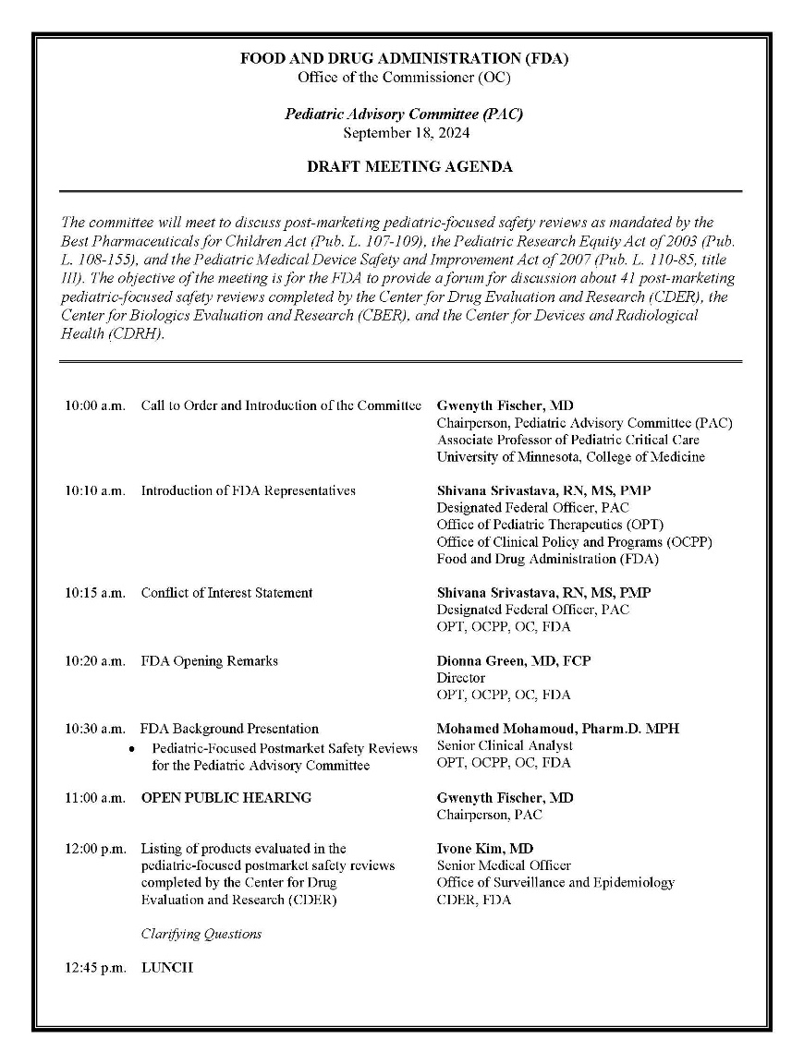
Pediatric Advisory Committee (PAC) Draft Meeting Agenda

Slide 15
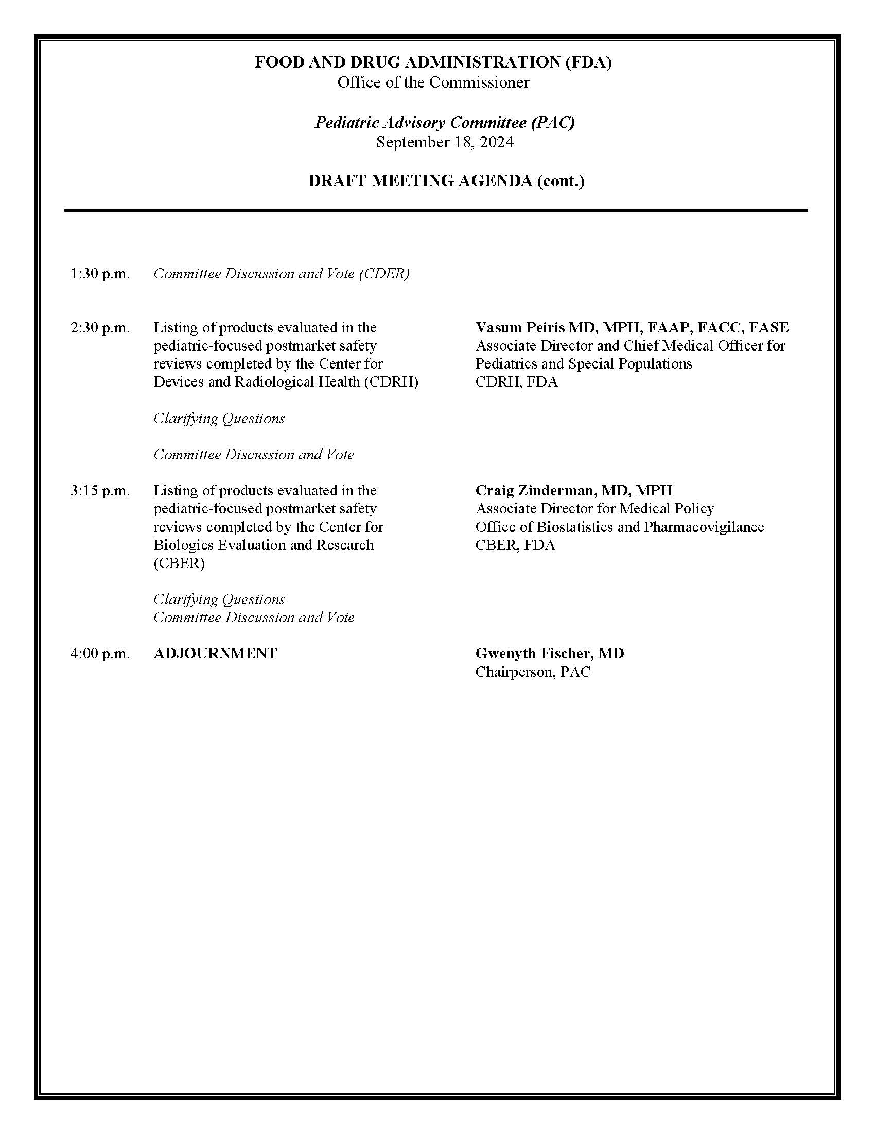
Pediatric Advisory Committee (PAC) Draft Meeting Agenda Cont.

Slide 16
Voting Procedures
3 separate voting sessions will be held (one each for CDER, CDRH, and CBER)
The voting question and answer choices will be the same for all Centers and all products
Voting will occur via the Zoom platform
A separate ballot will be launched for each Center’s vote
Each ballot will contain a series of voting questions – one for each of the products listed on the ballot
Note: Some CDER products were grouped into the same pediatric-focused postmarket safety review, and these products will be grouped for voting purposes as well

Slide 17
Voting Question and Meaning of Responses
FDA recommends continuing routine, ongoing postmarket safety monitoring of each of the [CDER/CDRH/CBER] products under discussion
Does the Pediatric Advisory Committee concur?
Yes – routine ongoing postmarket monitoring should continue
No – additional evaluation/surveillance should be considered
Abstain – insufficient information to make a yes/no decision
Recused – cannot vote due to conflicts of interest

Slide 18
Voting Procedures
During the vote, all meeting participants aside from the PAC will be moved to a breakout room
Meeting attendees trying to join the meeting during voting or vote tabulation will be placed in a waiting room until the meeting resumes, which may be ten minutes or more
Once the meeting resumes, the vote results will be displayed and read into the record
Each PAC member will be called upon to read out their individual vote for the record

Slide 19
FDA logo

Slide 20
Pediatric-Focused Postmarket Safety Reviews for the Pediatric Advisory Committee
Mohamed Mohamoud PharmD, MPH
Senior Clinical Analyst, Office of Pediatric Therapeutics
Office of Clinical Policy and Programs
Office of the Commissioner, FDA

Slide 21
Objectives
Outline legislation that created the Pediatric Advisory Committee (PAC) and established the PAC's role in postmarket pediatric safety monitoring
Summarize past and ongoing efforts to optimize how the PAC reviews pediatric-focused postmarket safety reviews
Present new changes for future engagement in postmarket pediatric safety monitoring

Slide 22
Best Pharmaceuticals for Children Act (BPCA) 2002
Followed Food and Drug Administration Modernization and Accountability Act (FDAMA) of 1997
Established incentive program for voluntarily completing pediatric studies of drugs and biologics
FDA Office of Pediatric Therapeutics (OPT)
Program for the studies for on-patent and off-patent products through the National Institute of Child Health and Human Development (NICHD)
Requirement for pediatric-focused postmarket safety reviews
During the one-year following the date on which a pediatric drug receives market exclusivity, any report of an adverse event must be reviewed by the FDA Pediatric Advisory Subcommittee of the Anti-Infective Drugs Advisory Committee
First safety presentation on June 12, 2003

Slide 23
Pediatric Research Equity Act (PREA) 2003
Followed the 1998 Pediatric Rule
Requirement for drugs and biologics to include an assessment of safety and effectiveness for the indication claimed in all relevant pediatric subpopulations
Support dosing and administration in pediatrics
Established the Pediatric Advisory Committee (PAC)
Previously a subcommittee of the Anti-Infective Drug Advisory Committee

Slide 24
The Food and Drug Administration Amendments Act (FDAAA) 2007
Reauthorized BPCA and PREA and extended the PAC until 2012
Gave the FDA authority (under BPCA & PREA) to label a product that has been studied in pediatrics, regardless of whether the drug was demonstrated to be safe and effective in pediatrics, including whether the results are inconclusive
Strengthened FDA authority to require the conduct of postmarketing studies to assess a known serious safety risk
Continued requirement for pediatric-focused postmarket safety reviews for products approved under BPCA and extended to products approved under PREA including biologics and vaccines
Changed PAC review to follow any pediatric labeling change pursuant to BPCA and PREA

Slide 25
Pediatric Medical Device Safety and Improvement Act (PMDSIA) 2007
PMDSIA 2007 was incorporated into FDAAA 2007
Humanitarian device exemption (HDE) is intended to benefit patients in the treatment or diagnosis of a disease or condition that affects or is manifested in not more than 8,000 individuals in the United States per year
Requires annual review of approved devices with Humanitarian Use Device designation labeled for pediatric patients that are allowed to make a profit
Requires the PAC to review adverse events on a periodic basis

Slide 26
The Food and Drug Administration Safety and Innovation (FDASIA) Act 2012
BPCA, PREA were reauthorized, and the PAC extended permanently
Requires that the PAC review all adverse event reports received in the 18 months after a pediatric labeling change for drugs and biologics, instead of the previous one-year review period

Slide 27
Mandated Pediatric-Focused Postmarket Safety Reviews
Adverse event reports in passive surveillance data
FDA Adverse Event Reporting System (FAERS)
Vaccine Adverse Event Reporting System (VAERS)
Manufacturer and User Facility Device Experience (MAUDE) Database
Periodic safety reports from manufacturers
Summary of any relevant post-approval studies
Summary of relevant peer-reviewed literature

Slide 28
Increasing Number of Pediatric Labeling Changes for Drugs and Biologics
FDAAA

Slide 29
Approaches to Streamline Pediatric-Focused Postmarket Safety Reviews
Initially, every pediatric postmarket safety review was formally presented to the PAC during a meeting
Over the years, OPT introduced different approaches for how FDA presents the reviews to the PAC, with the goal of optimizing use of FDA and PAC resources
2006 - abbreviated reviews
2010 - justified abbreviated reviews
2012 - designated abbreviated reviews
2016 - web-posted reviews for “low safety risk” products
Initially CDER products; expanded to CBER in 2017; and extended to CDRH in 2018

Slide 30
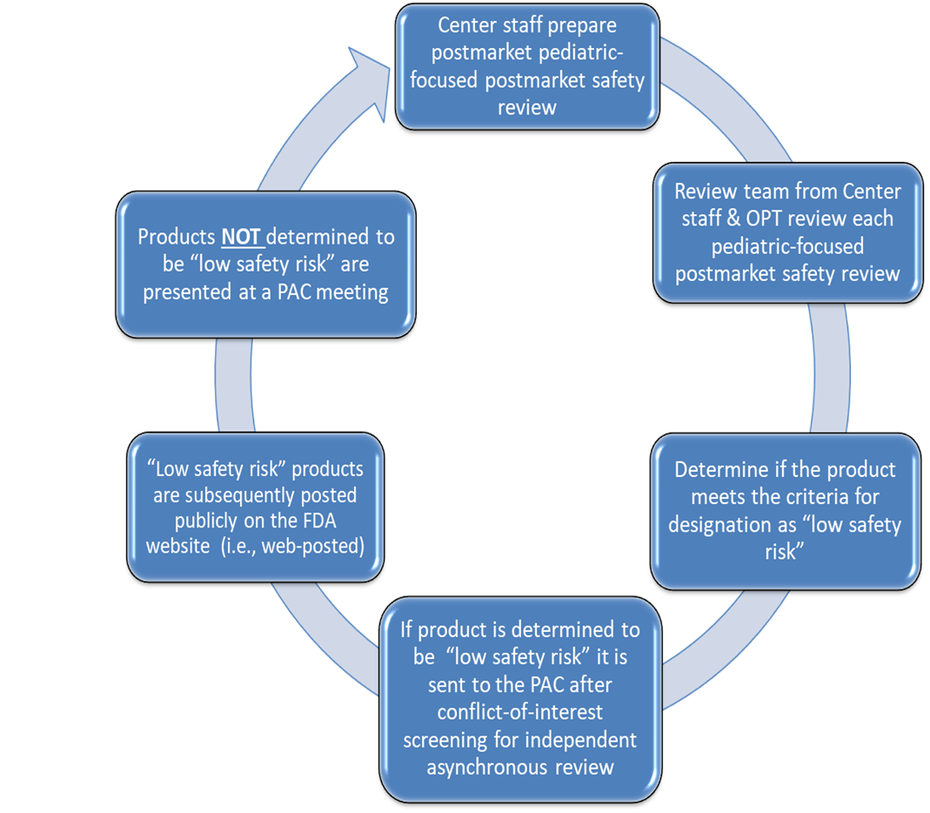
Process for Web-Posted Reviews Designated as “Low Safety Risk” Products

Slide 31
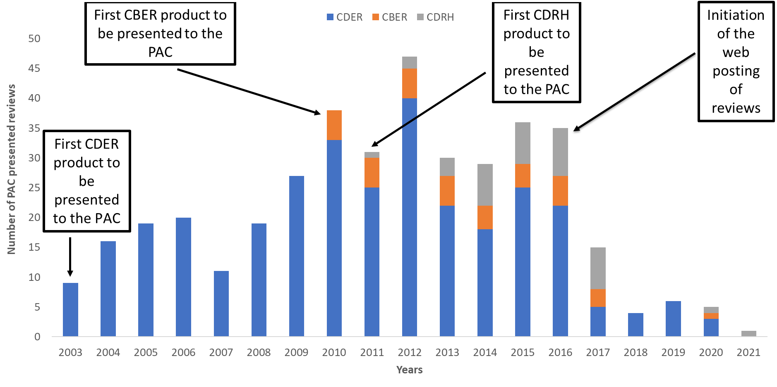
Reviews Presented to PAC 2003-2021 (n=398)

Slide 32
Web-posted Reviews for “Low Safety Risk” Products
Adopted criteria from previous approaches used to streamline pediatric-focused postmarket safety reviews
Potential to decrease backlog of CDER products awaiting PAC review
Safety reviews of products designated “low safety risk” are web-posted at FDA website and are no longer presented to the PAC during meetings
Led to more reviews being completed in a shorter duration
Allowed more time for PAC to discuss products that were not designated “low safety risk”
From 2016-2023, 364 web-posted pediatric-focused postmarket safety reviews were completed by CDER, CBER and CDRH

Slide 33
New Changes for Products Designated as "Low Safety Risk"
Pediatric-focused postmarket safety reviews for designated “low safety risk” products will continue to be sent to PAC members in advance of PAC meetings for asynchronous review
PAC members’ review will occur independently
OPT screens PAC members for conflicts of interest to assess their eligibility to review each product
OPT sends each PAC member a package of the documents for each product they are eligible to review
PAC members are encouraged to submit questions in advance of PAC meeting via email
PAC members will discuss products designated as “low safety risk” at PAC meetings to provide a public forum for discussion
During PAC meeting, PAC members can ask additional clarifying questions
PAC members will vote if they concur with FDA’s recommendation of continuing routine ongoing postmarket safety monitoring

Slide 34
Routine Ongoing Postmarket Safety Monitoring
What does it mean?
The product will return to ongoing surveillance that FDA does on a regular basis to detect possible safety signals
FDA safety evaluators review, assess and analyze incoming safety reports that FDA receives from sponsors, consumers and health care providers
FDA also reviews annual periodic safety reports from sponsors
These reviews of adverse events include all populations and are not specifically focusing on the pediatric population

Slide 35
Future Direction
Engage PAC in “low safety risk” drug, device and biologic products reviews during PAC meetings to provide an open forum for discussion and obtain any recommendations
Continue to present reviews with new safety concerns to the PAC for discussion and to obtain advice and recommendations
Continue to engage the PAC in other advisory committee activities
Explore alternatives ways to optimize FDA's approach to conducting pediatric-focused postmarket safety reviews

Slide 36
Thank You

Slide 37
Pediatric Advisory Committee Meeting September 18, 2024
Clarifying Questions

Slide 38
Open Public Hearing
Pediatric Advisory Committee Meeting
September 18, 2024
All OPH Speakers, please sign in by sending an email to PAC@fda.hhs.gov

Slide 39
Open Public Hearing
Speaker #1
Pediatric Advisory Committee Meeting
September 18, 2024

Slide 40
Pediatric Advisory Committee Meeting September 18, 2024
Center for Drug Evaluation and Research (CDER)

Slide 41
Center for Drug Evaluation and Research
1. AZSTARYS
(serdexmethylphenidate/dexmethylphenidate)
2. CAFCIT
(caffeine citrate)
3. CHANTIX
(varenicicline tartrate)
4. CIMDUO, TEMIXYS
(lamivudine/tenofovir disoproxil fumarate)
5. CLEOCIN HYDROCHLORIDE, CLEOCIN PHOSPHATE, CLEOCIN PHOSPHATE IN DEXTROSE 5% IN PLASTIC CONTAINER, CLINDAMYCIN PHOSPHATE IN 0.9% SODIUM CHLORIDE
(clindamycin hydrochloride, clindamycin phosphate)
6. DYANAVEL XR
(amphetamine)

Slide 42
Center for Drug Evaluation and Research
7. EVEKEO ODT
(amphetamine sulfate)
8. GATTEX
(teduglutide)
9. GILENYA, TASCENSO ODT
(fingolimod)
10. JANUVIA, JANUMET, JANUMET XR
(sitagliptin, sitagliptin/metformin HCl, sitagliptin/metformin hydrochloride extended release)
11. KAPSPARGO SPRINKLE
(metoprolol succinate extended release)
12. LITHIUM
(lithium carbonate, lithium oral solution)
13. LOTEMAX
(loteprednol etabonate)
14. LUMASON
(sulfur hexafluoride lipid-type A microspheres)
15. MAVYRET
(glecaprevir/pibrentasvir)
16. MIRCERA
(methoxy polyethylene glycol-epoetin beta)

Slide 43
Center for Drug Evaluation and Research
17. MULTRYS,TRALEMENT, ZINC SULFATE, SELENIOUS ACID
(trace elements)
18. MYDAYIS
(mixed salts of a single-entity amphetamine)
19. NATROBA
(spinosad)
20. PRADAXA
(dabigatran etexilate)
21. QELBREE
(viloxazine extended-release)
22. RIOMET ER
(metformin hydrochloride extended-release)
23. TEFLARO
(ceftaroline fosamil)
24. TIROSINT-SOL
(levothyroxine sodium)
25. TYBOST
(cobicistat)

Slide 44
Center for Drug Evaluation and Research
26. ULTRAVATE, LEXETTE
(halobetasol propionate)
27. VEKLURY
(remdesivir)
28. VYVANSE
(lisdexamfetamine dimesylate)
29. XACIATO
(clindamycin phosphate)
30. XEGLYZE
(abametapir)
31. XELSTRYM
(dextroamphetamine)
32. YERVOY
(ipilimumab)

Slide 45
Pediatric Advisory Committee Meeting September 18, 2024
Clarifying Questions

Slide 46
Pediatric Advisory Committee Meeting September 18, 2024
Lunch

Slide 47
Pediatric Advisory Committee Meeting September 18, 2024
Committee Vote

Slide 48
Voting Question
FDA recommends continuing routine, ongoing postmarket safety monitoring of each of the CDER products under discussion.
Does the Pediatric Advisory Committee concur?

Slide 49
Pediatric Advisory Committee Meeting September 18, 2024
Committee Voting
in Progress

Slide 50
Pediatric Advisory Committee Meeting September 18, 2024
Center for Devices and Radiological Health

Slide 51
Center for Devices and Radiological Health
CONTEGRA PULMONARY VALVED CONDUIT*
2. ENTERRA THERAPY SYSTEM*
3. FLOURISH PEDIATRIC ESOPHAGEAL ATRESIA DEVICE*
4. PLEXIMMUNE IN-VITRO DIAGNOSTIC TEST*
5. PULSERIDER ANEURYSM NECK RECONSTRUCTION DEVICE*
6. SONALLEVE MR-HIFU*
*(Humanitarian Device Exemption (HDE))

Slide 52
Pediatric Advisory Committee Meeting September 18, 2024
Clarifying Questions

Slide 53
Pediatric Advisory Committee Meeting September 18, 2024
Committee Vote

Slide 54
Voting Question
FDA recommends continuing routine, ongoing postmarket safety monitoring of each of the CDRH products under discussion.
Does the Pediatric Advisory Committee concur?

Slide 55
Pediatric Advisory Committee Meeting September 18, 2024
Committee Voting
in Progress

Slide 56
Pediatric Advisory Committee Meeting September 18, 2024
Center for Biologics Evaluation and Research

Slide 57
Center for Biologics Evaluation and Research
AGRIFLU (influenza virus vaccine)
2. CUTAQUIG (immune globulin subcutaneous (human)-hipp, 16.5%)
3. XYNTHA (antihemophilic factor (recombinant), plasma/albumin Free)

Slide 58
Pediatric Advisory Committee Meeting September 18, 2024
Clarifying Questions

Slide 59
Pediatric Advisory Committee Meeting September 18, 2024
Committee Vote

Slide 60
Voting Question
FDA recommends continuing routine, ongoing postmarket safety monitoring of each of the CBER products under discussion.
Does the Pediatric Advisory Committee concur?

Slide 61
Pediatric Advisory Committee Meeting September 18, 2024
Committee Voting
in Progress

Slide 62
Pediatric Advisory Committee Meeting September 18, 2024
Wrap-Up

Slide 63
Pediatric Advisory Committee Meeting September 18, 2024
Adjournment

