Slide 1
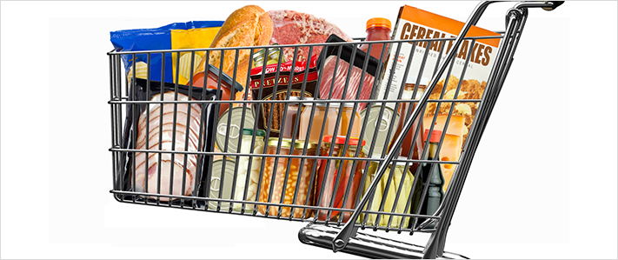
Sodium Reduction: FDA’s Voluntary Initiative
Susan Mayne, Ph.D., Director
Kasey Heintz, MS, Interdisciplinary Scientist
Center for Food Safety and Applied Nutrition
Food and Drug Administration

Slide 2
What did FDA Announce?
Draft, voluntary guidance on sodium reduction targets
Gradual approach:
Short-term targets (2 years, goal=3,000 mg/day)
Long-term targets (10 years, goal=2,300 mg/day)
Targets for 150 categories of food that are sales weighted to focus on dominant sellers in each category
Applies to food manufacturers, restaurants and food service operations
Draft targets serve as a basis for continued dialogue
Additional data and information will help refine

Slide 3
Why Focus on Sodium?
Americans consume almost 50 percent more sodium than what most experts recommend
Current intake is about 3,400 mg/day
Recommendation is 2,300 mg/day
Expert bodies agree on the need to reduce sodium consumption to 2,300 mg/day for public health gains
Institute of Medicine
Evidence used for 2015-2020 Dietary Guidelines for Americans
Healthy People 2020

Slide 4
Scientific Evidence
Totality of evidence supports sodium reduction from current levels
Diverse and strong body of evidence, including clinical trials, support link between sodium consumption and blood pressure
High blood pressure is a major risk factor for heart disease and stroke
Sodium reduction could prevent hundreds of thousands of premature deaths and illnesses over a decade

Slide 5
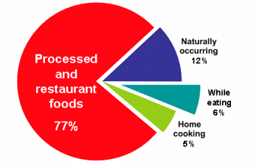
Why are Targets Needed?
Most sodium comes from salt added to processed and restaurant foods
It is difficult to meet recommended sodium intake with current food supply
Overall sodium content of food supply remains high, despite industry efforts
Variability in sodium across similar foods in food supply shows that reductions are possible
Mattes and Donnelly, 1991

Slide 6
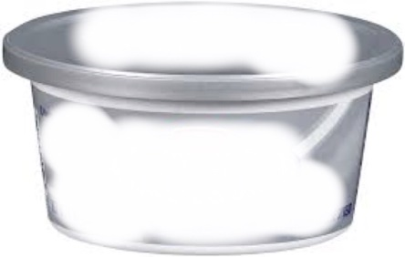
Example of Variability: Cream Cheese
Country | Sodium (mg/100g) | Short-Term Mean Target (mg/100g) | Long-Term Mean Target (mg/100g)
U.S. | 403 | 380 | 340
U.K. | 300 | N/A | N/A
Ireland | 300 | N/A | N/A
Australia | 348 | N/A | N/A
New Zealand | 348 | N/A | N/A
Canada | 400 | N/A | N/A
Brazil | 410 | N/A | N/A
Spreadable

Slide 7
Food Safety
Texture Development
Fermentation
Sodium/Salt
Color Development
Flavor

Slide 8
Key Information Considered
Survey of available food technology literature
Role of sodium (e.g., food safety, texture, fermentation)
Sodium reduction potential in food/food category
Comments
Market surveys
Sodium content of high-selling products
Identified products in 2010 that had the lowest sodium concentrations
Consultation with experts
Reviewed other sodium reduction initiatives

Slide 9
3-Step Process to Set Targets
1
Developed 150 food categories
Determined baseline sodium concentrations (mg/100g)
Set quantitative goals (2 year and 10 year)
2
3

Slide 10
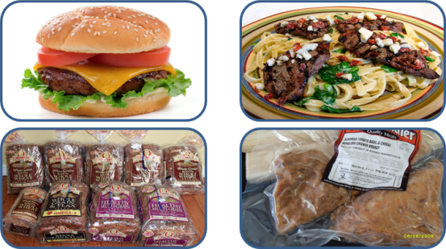
Step 1: Developed Food Categories
Reviewed various food categorization systems
Government
Private-sector
Sodium reduction initiatives
Captured USDA food codes
Grouped foods with similar technical feasibility of sodium reduction using food technology literature/data
Assessed contribution to sodium intake
Revised based on technical input
Includes
Processed foods (e.g., breads, marinated meats)
Foods prepared at retail (e.g., sandwiches, salads, mixed ingredient entrees)
Those available at both (e.g., pizza, soups)

Slide 11
Contribution of Foods to U.S. Sodium Intake by Sodium Guidance Targeted Foods
FDA Analysis, 2016

Slide 12
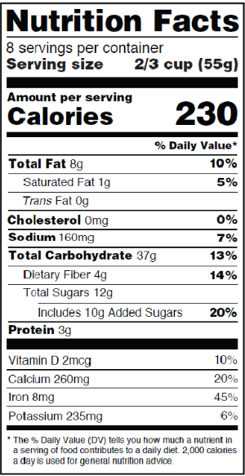
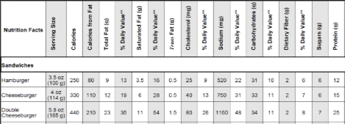
Step 2: Determined Baseline Sodium Concentrations
Baseline concentrations
Point of reference for reduction goals
Expressed as the concentration of sodium in a
food product (mg/100g)
Different amounts of data and levels of detail available for
packaged and restaurant foods (e.g. sandwich data better for restaurants)
Sources of data used combine the following
Sodium data from food package labels (2010) or restaurant menu data (2010-11)
Sales data (2010)
Processed food/restaurant data are weighted by sales data

Slide 13
Step 3: Set Quantitative Goals
Assessed options for types of goals – selected hybrid of sales-weighted mean and upper bound
Target mean levels: apply to average sodium levels of foods in a category, not individual products
Recommended upper bounds: apply to all individual products and discourage products with excessive sodium

Slide 14
Sales Weighting
Focus is on:
Manufacturers whose products make up a significant proportion of national sales in one or more categories
Restaurant and similar retail food chains that are national or regional in scope
Intended to provide more weight to commonly consumed products—the dominant sellers in each category
More reflective of the sodium intake from the U.S. food supply (10% of products account for top 80% of sales)
Company could assess own portfolio of products against category targets by determining sales-weighted mean for products in a category

Slide 15
Calculating Upper Bounds What was taken into account?
General Calculation
Percentile of 2010 baseline distribution
Percentage of target mean
÷
2
Short-term Upper Bound
80th percentile of baseline distribution
130% of Short-term mean
÷
2
Long-term Upper Bound
60th percentile of baseline distribution
130% of long-term
mean
÷
2

Slide 16
Target Table
P = Packaged; R = Restaurant; both = P and R; (baseline values are based on data available for P and R)
All values are in milligrams (mg) per 100 grams (g)

Slide 17
Sample Category: Precooked Sausage
Top selling products on market
Shows how sodium concentrations compare (mg/100g)
Baseline, FDA short- and long-term targets overlaid
Many products already meeting short- and long-term targets
Note: Data on the number of products was obtained from Nielsen. Sodium concentration values were calculated from sodium values on nutrition labels obtained from Gladson and Mintel.

Slide 18
Sample Category: Monterey Jack and Other Semi-Soft Cheese
Note: Data on the number of products was obtained from Nielsen. Sodium concentration values were calculated from sodium values on nutrition labels obtained from Gladson and Mintel.

Slide 19
Sample Category: Wheat and Mixed Grain Bread
Sodium Concentration (mg Na/100g) n = 69 products; 35 brands
Note: Data on the number of products was obtained from Nielsen. Sodium concentration values were calculated from sodium values on nutrition labels obtained from Gladson and Mintel.

Slide 20
Monitoring Plans
FDA:
Industry progress in achieving the targets for each food category
USDA, CDC:
Sentinel surveillance of specific foods over time that have high sodium levels or are significant contributors to sodium intake
Sodium intake through dietary recalls (USDA - What We Eat in America/NHANES) and through urinary data (CDC - NHANES)

Slide 21
Stakeholder Participation Important
All parties must work together to see success

Slide 22
Comments
Separate comment periods for short- and long-term targets
90 days on issues outlined in the Notice of Availability regarding the short-term targets
150 days on issues outlined in the Notice of Availability regarding the long-term targets
Link to docket: https://www.regulations.gov/#!docketDetail;D=FDA-2014-D-0055

Slide 23
Specific Feedback Requested…
Categories
Have we miscategorized products?
Should categories be separated or merged?
amenable for use by restaurant chains ?
Baselines
Are they representative of the state of the food supply in 2010 for each category?
Can our methods for quantifying sodium content be improved and if so, how?
Please submit comments to the docket!

Slide 24
Specific Feedback Requested…
Targets
Can our methods for developing mean and recommended upper bound targets be improved and if so, how?
Are they feasible for 2 years and if not, why?
Are they feasible for 10 years and if not, why?
What timelines are appropriate for each food category?
Are there research needs or technological advances that could enhance the ability to meet these goals?
Please submit comments to the docket!

Slide 25
Specific Feedback Requested…
Reformulation
What are the possible innovations in the area of sodium reduction?
Are there any unintended consequences associated with their use?
Other Considerations
What amendments to FDA’s standard of identity regulations are needed to facilitate sodium reduction?
Are there other information gaps that we are overlooking?
Please submit comments to the docket!

Slide 26
Documentation on Methodology in the Docket
Reference 07 (to NOA) - Supplementary Target Development Example
https://www.regulations.gov/#!documentDetail;D=FDA-2014-D-0055-0221
Reference 17 (to Draft Guidance) - Supplementary Materials Packet: Voluntary Sodium Reduction Goals: Target Mean and Upper Bound Concentrations for Sodium in Commercially Processed, Packaged, and Prepared Foods; Draft Guidance for Industry; Availability
https://www.regulations.gov/#!documentDetail;D=FDA-2014-D-0055-0011

Slide 27
For More Information
FDA Website: www.fda.gov/SodiumReduction
Draft Guidance
Notice of Availability (includes issues for comment)
Draft sodium reduction targets (available in Excel or Word format)
At a Glance fact sheet
FAQ
Email: SodiumReduction@fda.hhs.gov

